Slide 1
On Well-Being: Your Residents’ and Your Own
Stuart Slavin, MD, MEd
Senior Scholar for Well-being
Accreditation Council for Graduate
Medical Education (ACGME)

Slide 2
Disclosures
I have no financial disclosures to make.

Slide 3
The Health Care Setting
A Grim Picture

Slide 4
The Health Care Setting
A Grim Picture
Medical students
Depression rate 27%
Anxiety and burnout in more than half

Slide 5
The Health Care Setting
A Grim Picture
Medical students
Depression rate 27%
Anxiety and burnout in more than half
Residents
Burnout 60-75% and higher

Slide 6
The Health Care Setting
A Grim Picture
Medical students
Depression rate 27%
Anxiety and burnout in more than half
Residents
Burnout 60-75% and higher
Physicians
Burnout rate 54% and rising
Highest suicide rate of any profession

Slide 7
The Health Care Setting
A Grim Picture
Medical students
Depression rate 27%
Anxiety and burnout in more than half
Residents
Burnout 60-75% and higher
Physicians
Burnout rate 54% and rising
Highest suicide rate of any profession
Coordinators?

Slide 8
Saint Louis University Medical Student Mental Health

Slide 9
Saint Louis University Medical Student Mental Health
Moderate- Severe Symptoms of Depression (% of class)
 | Orient. | MS1 (EOY) | MS2 (EOY)
Class of 2011 | 6 | 27 | 29
Class of 2012 | 6 | 27 | 35

Slide 10
Saint Louis University Medical Student Mental Health
Moderate- Severe Symptoms of Anxiety (% of class)
 | Orient. | MS1 | MS2
Class of 2011 | 33 | 56 | 58
Class of 2012 | 27 | 54 | 61

Slide 11
A Simple Model

Slide 12
A Simple Model
Reduce unnecessary stressors and enhance the
learning environment

Slide 13
A Simple Model
Reduce unnecessary stressors and enhance the
learning environment
Increase students’ ability to deal with stress

Slide 14
A Simple Model
Reduce unnecessary stressors and enhance the
learning environment
Increase students’ ability to deal with stress
Help students find meaning in their work

Slide 15
The Interventions

Slide 16
The Interventions
2009- Pass/ Fail grading in 1st two years, cut curriculum by 10%,
instituted longitudinal electives and theme-based learning
communities

Slide 17
The Interventions
2009- Pass/ Fail grading in 1st two years, cut curriculum by 10%,
instituted longitudinal electives and theme-based learning
communities
2010- Resilience and mindfulness curriculum for 1st years

Slide 18
The Interventions
2009- Pass/ Fail grading in 1st two years, cut curriculum by 10%,
instituted longitudinal electives and theme-based learning
communities
2010- Resilience and mindfulness curriculum for 1st years
2011- Changes to the Human Anatomy course

Slide 19
The Interventions
2009- Pass/ Fail grading in 1st two years, cut curriculum by 10%,
instituted longitudinal electives and theme-based learning
communities
2010- Resilience and mindfulness curriculum for 1st years
2011- Changes to the Human Anatomy course
2012- Change to “true” pass/ fail in 1st two years
2013- Restructured the four year curriculum to allow early start
and end to the 3rd year
2014- Confidential tracking of depression and anxiety
2015- Focused support of 2nd years in run-up to Step 1

Slide 20
Mental Health Impact
Moderate- Severe Symptoms of Depression (% of class)
 | Orient. | MS1 | MS2
Class of 2011 | 6 | 27 | 29
Class of 2012 | 6 | 27 | 35
Class of 2018 | 4 | 4 | 6

Slide 21
Mental Health Impact
Moderate- Severe Symptoms of Anxiety (% of class)
 | Orient. | MS1 | MS2
Class of 2011 | 33 | 56 | 58
Class of 2012 | 27 | 54 | 61
Class of 2018 | 21 | 14 | 32

Slide 22
External Bench-Marking
AAMC
Year 2
Questionnaire

Slide 23
External Bench-Marking
AAMC
Year 2
Questionnaire
 | National | SLU
Emotional Climate | 9.2 | 10.8
Student-fac. interaction | 14.8 | 16.0
Quality of life | 40.1 | 45.5
Perceived stress | 5.8 | 4.7
Disengagement | 9.7 | 8.2
Exhaustion | 11.8 | 9.3

Slide 24
Impact
But what happened to academic performance???

Slide 25
Impact
USMLE Step 1 performance
 | Mean | Failure rate
Classes of 2011 and 2012 | 224 | 4%
Class of 2018 | 228 | 2%

Slide 26
Reflections and Recommendations

Slide 27
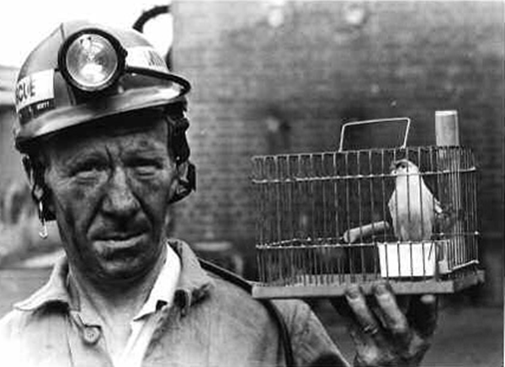

Slide 28
Reflections and Recommendations
We need to develop a deep understanding of the lived experience of those we are trying to help.

Slide 29
Reflections and Recommendations
The lived experience is not only driven by the environment.

Slide 30
Other Drivers of Poor Mental Health

Slide 31
Other Drivers of Poor Mental Health

Slide 32
Problematic Mindsets

Slide 33
Problematic Mindsets
Comparison

Slide 34
Problematic Mindsets
Comparison
Seeing performance as identity

Slide 35
Problematic Mindsets
Comparison
Seeing performance as identity
Personalization and self-blame

Slide 36
Problematic Mindsets
Comparison
Seeing performance as identity
Personalization and self-blame
Feelings of inadequacy, embarrassment, and shame

Slide 37
Problematic Mindsets
Comparison
Seeing performance as identity
Personalization and self-blame
Feelings of inadequacy, embarrassment, and shame
Cognitive distortions (multiple)

Slide 38
Problematic Mindsets
Comparison
Seeing performance as identity
Personalization and self-blame
Feelings of inadequacy, embarrassment, and shame
Cognitive distortions (multiple)
Maladaptive perfectionism

Slide 39
Problematic Mindsets
Comparison
Seeing performance as identity
Personalization and self-blame
Feelings of inadequacy, embarrassment, and shame
Cognitive distortions (multiple)
Maladaptive perfectionism
Imposter phenomenon

Slide 40
Problematic Mindsets
Comparison
Seeing performance as identity
Personalization and self-blame
Feelings of inadequacy, embarrassment, and shame
Cognitive distortions (multiple)
Maladaptive perfectionism
Imposter phenomenon
Stanford Duck

Slide 41
Problematic Mindsets
Comparison
Seeing performance as identity
Personalization and self-blame
Feelings of inadequacy, embarrassment, and shame
Cognitive distortions (multiple)
Maladaptive perfectionism
Imposter phenomenon
Stanford Duck
Chasing success

Slide 42
Problematic Mindsets
Comparison
Seeing performance as identity
Personalization and self-blame
Feelings of inadequacy, embarrassment, and shame
Cognitive distortions (multiple)
Maladaptive perfectionism
Imposter phenomenon
Stanford Duck
Chasing success
Fixed versus growth mindset

Slide 43
Problematic Mindsets
Comparison
Seeing performance as identity
Personalization and self-blame
Feelings of inadequacy, embarrassment, and shame
Cognitive distortions (multiple)
Maladaptive perfectionism
Imposter phenomenon
Stanford Duck
Chasing success
Fixed versus growth mindset
Stigma around seeking care for mental health problems

Slide 44
But There’s Hope!!!

Slide 45
But There’s Hope!!!
It’s up to you to create meaning from experience.

Slide 46
Cognitive Restructuring

Slide 47
Cognitive Restructuring
Adverse event = Outcome

Slide 48
Cognitive Restructuring
Adverse event = Outcome
False!!
Adverse event + your cognitive/emotional
reaction = Outcome

Slide 49
Cognitive Restructuring
Common
Cognitive/Emotional
Distortions
Magnifying or catastrophizing
All or nothing thinking
Overgeneralization
Tunnel vision
Fortune-telling
Personalization and blame
Mind-reading
Perfectionistic thinking

Slide 50
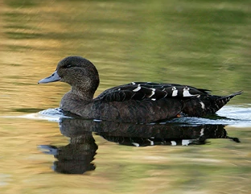
Cognitive Restructuring
Common
Cognitive/Emotional
Distortions
Magnifying or catastrophizing
All or nothing thinking
Overgeneralization
Tunnel vision
Fortune-telling
Personalization and blame
Mind-reading
Perfectionistic thinking
I’m the only one suffering this much (Standford duck)

Slide 51
Cognitive Restructuring
Common
Cognitive/Emotional
Distortions
Magnifying or catastrophizing
All or nothing thinking
Overgeneralization
Tunnel vision
Fortune-telling
Personalization and blame
Mind-reading
Perfectionistic thinking
I’m the only one suffering this much (Standford duck)
Disbelief if anyone tries to counter one’s distortions

Slide 52
Cognitive Restructuring
How to counter

Slide 53
Cognitive Restructuring
How to counter
Notice

Slide 54
Cognitive Restructuring
How to counter
Notice
Label

Slide 55
Cognitive Restructuring
How to counter
Notice
Label
Dispute

Slide 57
Mindfulness

Slide 58
Mindfulness
Paying attention in a particular way: on purpose, in the present moment, and nonjudgmentally.
Jon Kabat-Zinn

Slide 59
Mindfulness
Metacognition

Slide 60
Resilience
Mindfulness
Metacognition

Slide 61
Other Tools

Slide 62
Other Tools
Cultivating positive emotions

Slide 63
Other Tools
Cultivating positive emotions
Combating negativity bias

Slide 64
Other Tools
Cultivating positive emotions
Combating negativity bias
Cultivating optimism

Slide 65
Other Tools
Cultivating positive emotions
Combating negativity bias
Cultivating optimism
Emotional self-regulation

Slide 66
Other Tools
Cultivating positive emotions
Combating negativity bias
Cultivating optimism
Emotional self-regulation
Dealing with difficult people

Slide 67
Other Tools
Cultivating positive emotions
Combating negativity bias
Cultivating optimism
Emotional self-regulation
Dealing with difficult people
Investing in your well-being

Slide 68
Other Tools
Cultivating positive emotions
Combating negativity bias
Cultivating optimism
Emotional self-regulation
Dealing with difficult people
Investing in your well-being
Avoiding learned helplessness

Slide 69
Reflections and Recommendations
But we also have to work on the coal mines

Slide 70
Improving the Clinical Work Environment
Drivers of Burnout
Workload
Rewards
Control
Community
Fairness
Values
Maslach and Leiter, 1997

Slide 71
Improving the Clinical Work Environment
Clients do not come first.
Employees come first.
If you take care of your employees, they’ll take care of the clients.
Richard Branson

Slide 72
Beyond Curriculum to Culture

Slide 73
Beyond Curriculum to Culture
AAMC
Graduation
Questionnaire

Slide 74
Beyond Curriculum to Culture
AAMC
Graduation
Questionnaire
Students were asked to rate their satisfaction with the Office of the Dean for Curricular Affairs on accessibility, awareness of student concerns, and responsiveness to student problems.
(5-point Likert scale from very satisfied to
very dissatisfied)

Slide 75
Beyond Curriculum to Culture
AAMC
Graduation
Questionnaire
Students were asked to rate their satisfaction with the Office of the Dean for Curricular Affairs on accessibility, awareness of student concerns, and responsiveness to student problems.
(5-point Likert scale from very satisfied to
very dissatisfied)
Nationally- 32.8% very satisfied
SLU- 76.1% very satisfied

Slide 76
Beyond Curriculum to Culture
AAMC
Graduation
Questionnaire
Satisfaction with programs/ activities that promote effective stress management, a balanced lifestyle, and overall well-being.

Slide 77
Beyond Curriculum to Culture
AAMC
Graduation
Questionnaire
Satisfaction with programs/ activities that promote effective stress management, a balanced lifestyle, and overall well-being.
Nationally- 33.3% very satisfied
SLU- 81.2% very satisfied

Slide 78
If we take man as he is, we make him worse, but if we take man as he should be, we make him capable of becoming what he can be.
Viktor Frankl

Slide 79
Beyond Curriculum to Culture
AAMC
Graduation
Questionnaire
Agreement with statement “My medical school has done a good job of fostering and nurturing my development as a person.”
(5-point Likert scale from strongly agree to
strongly disagree)

Slide 80
Beyond Curriculum to Culture
AAMC
Graduation
Questionnaire
Agreement with statement “My medical school has done a good job of fostering and nurturing my development as a person.”
(5-point Likert scale from strongly agree to
strongly disagree)
Nationally- 33.8% strongly agree
SLU- 65.0% strongly agree

Slide 81
The Importance of Meaning

Slide 82
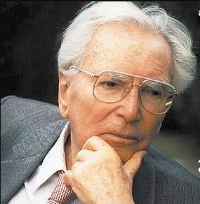
Viktor Frankl

Slide 83
Viktor Frankl
There is nothing in the world, I venture to say, that would so effectively help one to survive even the worst conditions as the knowledge that there is a meaning in one’s life.

Slide 84
Viktor Frankl
There is nothing in the world, I venture to say, that would so effectively help one to survive even the worst conditions as the knowledge that there is a meaning in one’s life.
There is much wisdom in the words of Nietzsche, “He who has a why to live for can bear almost any how.”

