Slide 1

After the Fall
Remediation in GME

Slide 2


Slide 3
Objectives
Recognize the differences between academic problems and misconduct.
Collect documentation from RMS to support decision-making.
Manage multiple sources of information to provide assistance to the PD and prepare for possible appeal(s).

Slide 4
Policies
Academic Improvement
  Struggles in one or more of the 6 competencies
  Determined to be remediable
  Timeframe for remediation
Misconduct
  Willful behavior contrary to professional standards
  May be remediable. Doesn’t have to be.

Slide 5
Academic Improvement
Most common
Often more than one competency involved
Deficiency(ies) must be spelled out and a plan put in place to remediate with specific, reasonable dates.
Enhanced evaluation should be part of the process.
The coordinator will be worked harder to ensure that proper documentation is being gathered and collated for the PD and the CCC. The CCC is new:

Slide 6
CCC Role
ACGME CPR V.A.1.b).(1).(c)
  The CCC should advise the program director regarding resident progress, including promotion, remediation, and dismissal
  This is logical when it comes to Academic Improvement, but not as intuitive when it comes to misconduct.
  The CPR does not make this distinction, however.

Slide 7
Misconduct
Knowingly act in a manner that goes against the rules of ethical professional behavior.
The key word is:
Sometimes it is “just” disruptive behavior
Sometimes, it is reclassified as a lapse in professionalism and is handled under the Academic Improvement policy.

Slide 8
Coordinator Role
You are the keeper of the records
Produce evaluations and other documents that have been stored in the resident file/RMS
Serve in an advisory capacity to the PD, especially in regards to timelines.
Document, document, document.

Slide 9
Scenario 1
Dr. Smith is a PGY1. The stress of preparing for Step 3 has overwhelmed and the decision is made to skip out on work for a week to study. The communication to the elective Attending was that it was excused by the program, but no communication was ever had with the program leadership. This was only discovered after the rotation when a comment was made on the evaluation.

Slide 10
Scenario 2
Dr. Jones is in their last year of training. The love bug has bitten, but it is from a medical student who is currently under their direct supervision. No communication has been received from Dr. Jones or the medical student, but it is the talk of the residency and it has finally reached you.

Slide 11
What if they stay?
Same rights and privileges
Don’t be bullied or discouraged
Maintain meticulous documentation
  Minutes
  Evaluations
  Schedules
  Emails
  Appointments

Slide 12
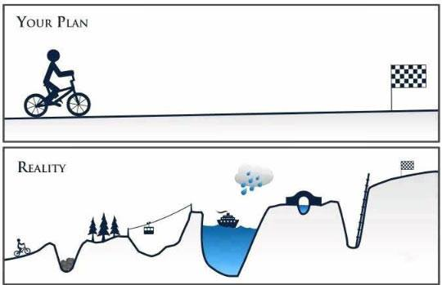

Slide 13
Discussion

