Slide 1
Balancing Act: Keep Burnout at Bay
Michael Boland, MMCGME Services

Slide 3
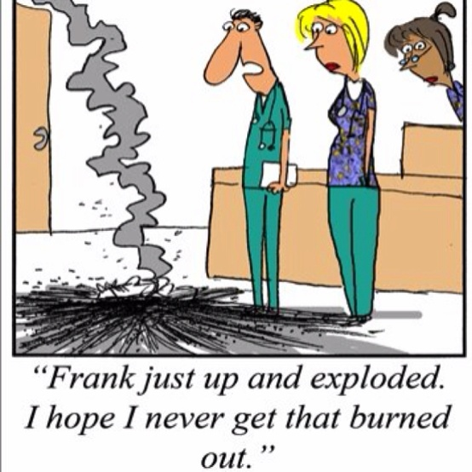
“You are the biggest burnout I know. And now you’re going to teach me how to avoid it?” -------------------------------

Slide 4
“Deep Thoughts”
Burnout is:
Lost energy
Lost enthusiasm
Lost confidence
“I’ve been done wrong”
“This is not the way it’s supposed to be”
“It’s driving me crazy”
“Stop the World - I want to get off”
“I’m mad as hell and I’m not going to take it anymore”
Notes:
Deep Thoughts by Jack Handy

Slide 5
Program Director
Clinical Staff
Faculty
YOU
Family/ Friends
Residents/ Fellows
“Attitudes are contagious” – positive OR negative!

Slide 6
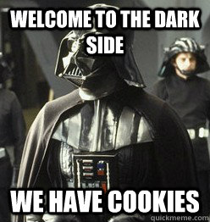
Stories from the dark side!
Seriously?
”the OB-GYN appointment”
“your noises may bother people”
I want, I want, I want….Give Me, Give Me
Leadership mistakes:
Refusing to provide the necessary support that I need to complete my projects
Ignoring my emotions or fears relating to changes
Blaming me for problems that are outside of my control
Overlooking or ridiculing my experience and KSA’s (knowledge, skills, abilities)
Never recognizing or thanking me for a job well done
Micromanaging

Slide 7
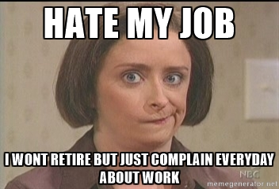
Why you hate work!
https://www.youtube.com/watch?v=Q0KZOktrKBg
Notes:
Tony Schwartz - founder and CEO of The Energy Project. 1- Renewal; 2- Emotional Needs (feel valued); 3- Focus; 4- Sense of Purpose
depth of despair; cynacism

Slide 9
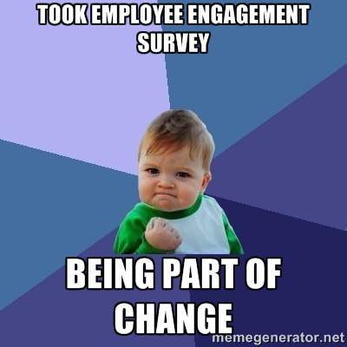
Employee Engagement is:
Understanding one’s role in organization
Feeling energized
Feeling pride and loyalty to organization
Organization’s actions consistent with core values
Wanting to “go the extra mile”
My contribution to the mission matters
Less sick time off from work

Slide 10
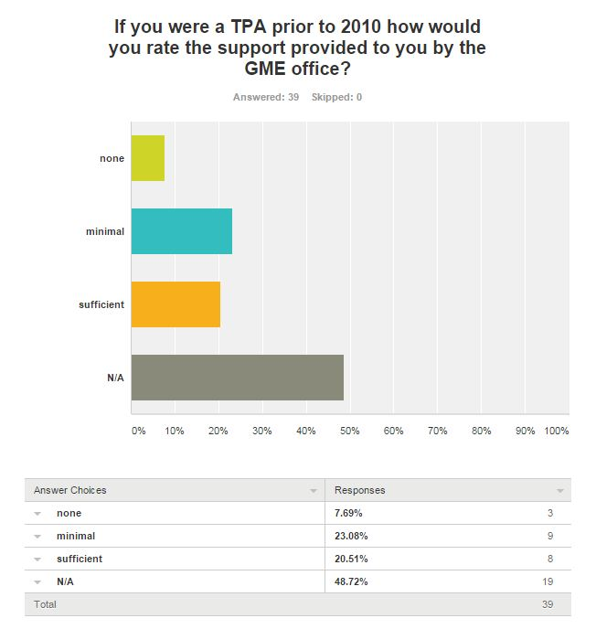
What Our Survey Showed
Notes:
Prior to 2010 the GME office was not in the habit of providing very many activities that engaged TPAs. As you can see from this chart the survey resulted in only 21% believing GME provided sufficient support.

Slide 11
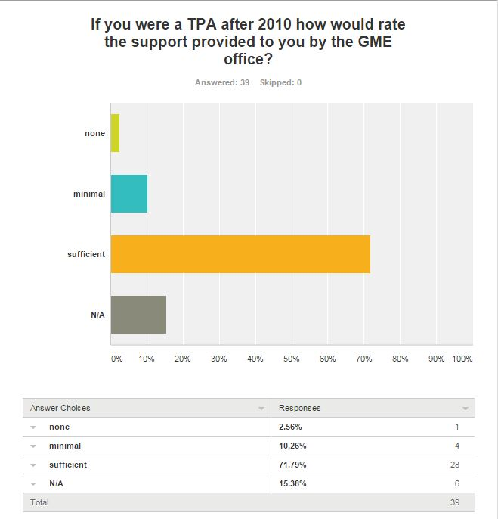
What Our Survey Showed
Notes:
After 2010 the GME office began introducing a variety of activities that began engaging TPAs . This has resulted in more than 70% indicating that the GME office now provides sufficient support of TPAs.

Slide 12
What Activities Have Been Offered for Coordinators?
Development of a GME-focused job description
TPA award of excellence
Instituted “Striving for Excellence” Professional Development Program
Salary Survey
Combined TPAC/PDAC meetings
TPA Development Day Seminar
TPA Handbook
Establish of TPAC Council
TPA Milestones and Self-Evaluation
TPA Appreciation Reception
TPAC Meetings (quarterly)
Participation in AHME webinars

Slide 13
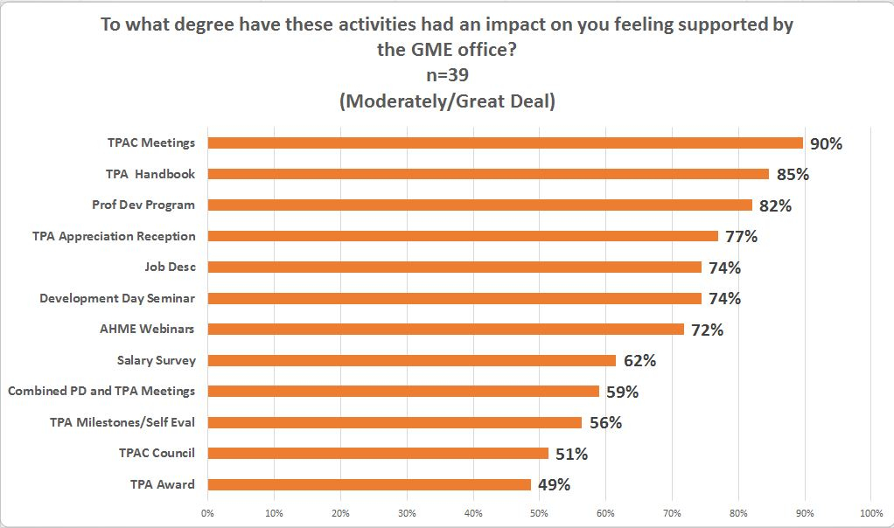
What Our Survey Showed
Notes:
The creation of the TPAC meetings and NewTPA handbook were the activities that the TPAs indicated felt most supported by our GME office. With the formation of our TPAC council this data will be shared with our TPAs and we will solicit feedback to determine what other ideas for activities the GME office can provide to offer support and engage the TPAs. Because motivation to engage is so individual, The University at Buffalo GME office and the TPAC council think it is important to continually monitor if the current activities offered to TPAs are activities they will engage in, and , are the activities effective in helping to deal with the stress and possible burnout from the job they are performing.
Addition from SMS: Creation of the TPA Award of Excellence had little impact on TPAs feeling supported, the complete opposite of GME’s intention when implementing it. One of the takeaways for GME staff would be to survey your constituents before putting resources into activities

Slide 14
What Does Being A Member of TPAC Mean To You?
“...being part of a supportive community dedicated to excellence and success”
“That I have support and guidance from peers who experience similar experiences and or frustrations”
“It makes me feel recognized and appreciated…”
“Being a member of TPAC helps me to know I am not alone”

Slide 15
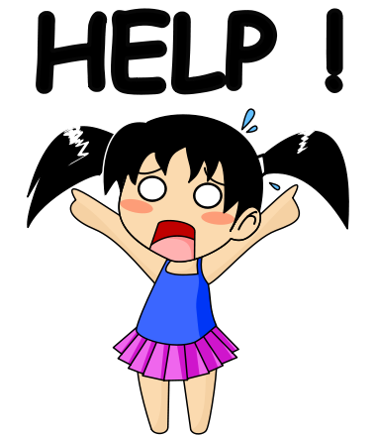
The Signs………….
…and what to do about it!

Slide 16
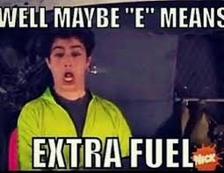
Emotional exhaustion
This is manifested by an individual feeling overstretched by the professional responsibilities of the job and having absolutely no reserve left. Emotional exhaustion is somewhat akin to a car that has run out of gas.
What To Do:
Get Active
Distract Yourself with Something You Love
Get a Change of Scenery
Get Out and Meet People
Change your Attitude Day by Day

Slide 17
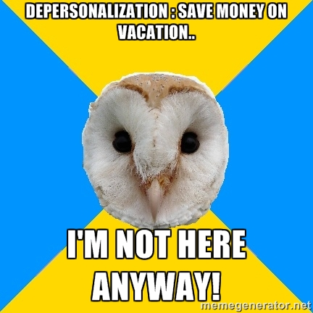
Depersonalization
The second telltale sign of burnout is depersonalization, a process of detachment from others.
What To Do:
Break Up Your Routine
Stop saying/thinking
I’ve been doing it this way for 30 years
Meditation
Take A Walk

Slide 18
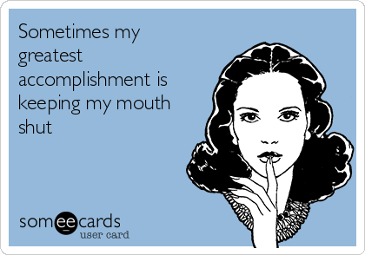
Lack of personal accomplishment
The final characteristic of burnout is a lack of feelings of personal accomplishment, deriving no personal joy or meaning from work.
What To Do:
Review Your Accomplishments Regularly
Check to See if Your Goals are Realistic

Slide 19
Is there a cure?
organization’s practices around meetings, email, flexible work arrangements, conflict resolution, recognition….
forge a more productive working relationship with the difficult boss
“tame the monkey”
purge your toxins
reward yourself
“NOBODY EVER DIES IN GME”
so let’s play nice in the sandbox
Notes:
Tame the Monkey - your mind is always on the move: clarity, become an observer, breathe, be kind, and practice gratitude.
Purge your toxins - exercise, get enough sleep

Slide 20
2016 GME COORDINATOR CONFERENCE
Two Halves of a Whole : Wellness and Professional Development for Coordinators and Trainees
Yearly event sponsored by the area teaching hospitals and University GME.
Run by and for coordinators
This year’s keynote speaker is Dr. Louis Ling from the ACGME
Speakers on burnout, wellness, professional development
Notes:
10% Happier: How I Tamed the Voice in My Head, Reduced Stress Without Losing My Edge, and Found Self-Help That Actually Works--A True Story

Slide 21
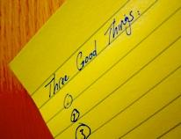
Three Good Things
Step 1: Think about anything good that happened to you today (or yesterday).
It can be anything at all that seems positive to you. It need not be anything big or important. Anything from the most mundane to the most exalted works, as long as it seems to you like a good, positive, happy thing.
Step 2: Write down these three positive things.
Step 3: Reflect on why each good thing happened.
Determining the "why" of the event is the most important part of the exercise. For example, you might say that your oatmeal tasted really good this morning because your partner took the time to go shopping at the local farmer's market, where they have fresh, organic oatmeal. You get to decide reasons for each event that make sense to you.

Slide 22
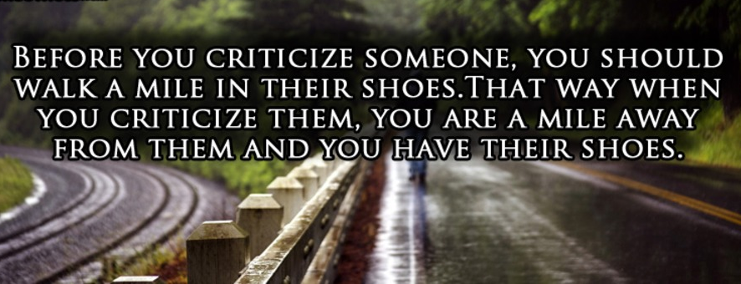

Slide 23
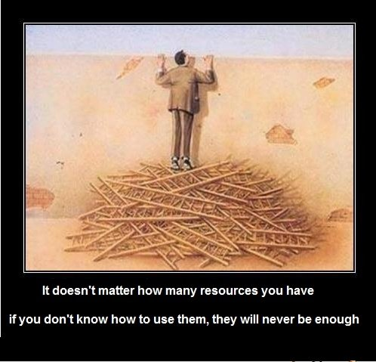

Slide 24
SUGGESTED READING AND SITES
www.dukepatientsafetycenter.com
Classes/Courses, “3 Good Things” online participation study, and more!
“Flourish” – Martin E. P. Seligman
“Positivity” - Barbara Friedrickson
“Born to be Good” – Dacher Keltner
The Greater Good Science Center
https://www.youtube.com/user/greatergoodscience
“The Science of Happiness – An Experiment in Gratitude”
http://soulpancake.com/portfolio_page/science-of-happiness/

Slide 25
Other Resources
Employee Assistance Program
http://www.mayoclinic.org/healthy-lifestyle/
http://psychology.berkeley.edu/people/christina-maslach
http://www.10percenthappier.com/mindfulness-meditation-the-basics/
http://99u.com/articles/24201/11-ways-to-avoid-burnout
Leiter, Michael P.; Maslach, Christina: Banishing Burnout: Six Strategies for Improving Your Relationship With Work. John Wiley & Sons.

Slide 26
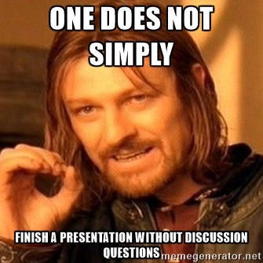
Discussion Points:
Work-Life Balance -
how to achieve & maintain it
You can't do it all in one day!
Take a lunch break!
How much is enough and
when to say NO?
Additions to your job after you've been hired - how do you ask for more pay or do you?

Slide 27
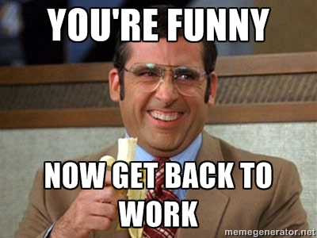
THANK YOU!

