Slide 1
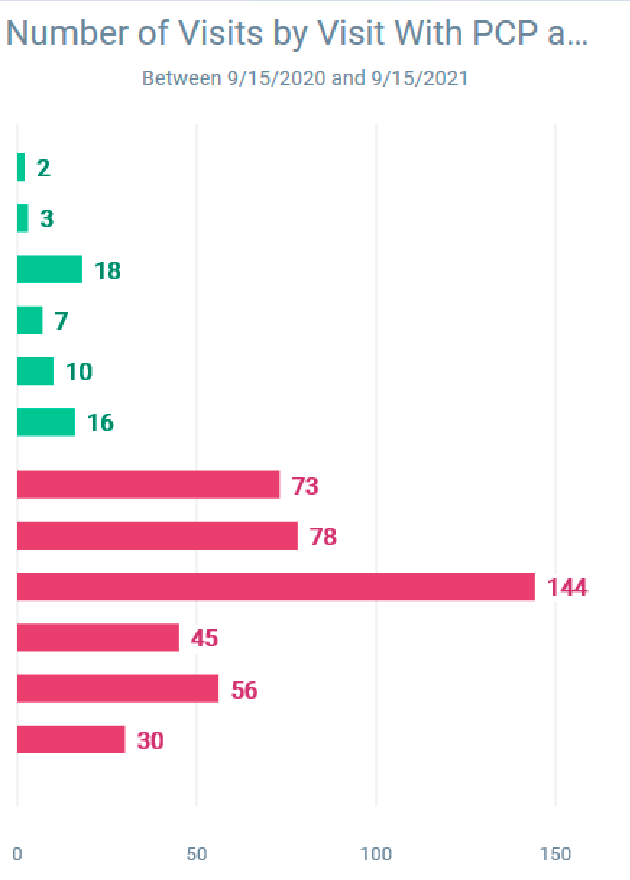
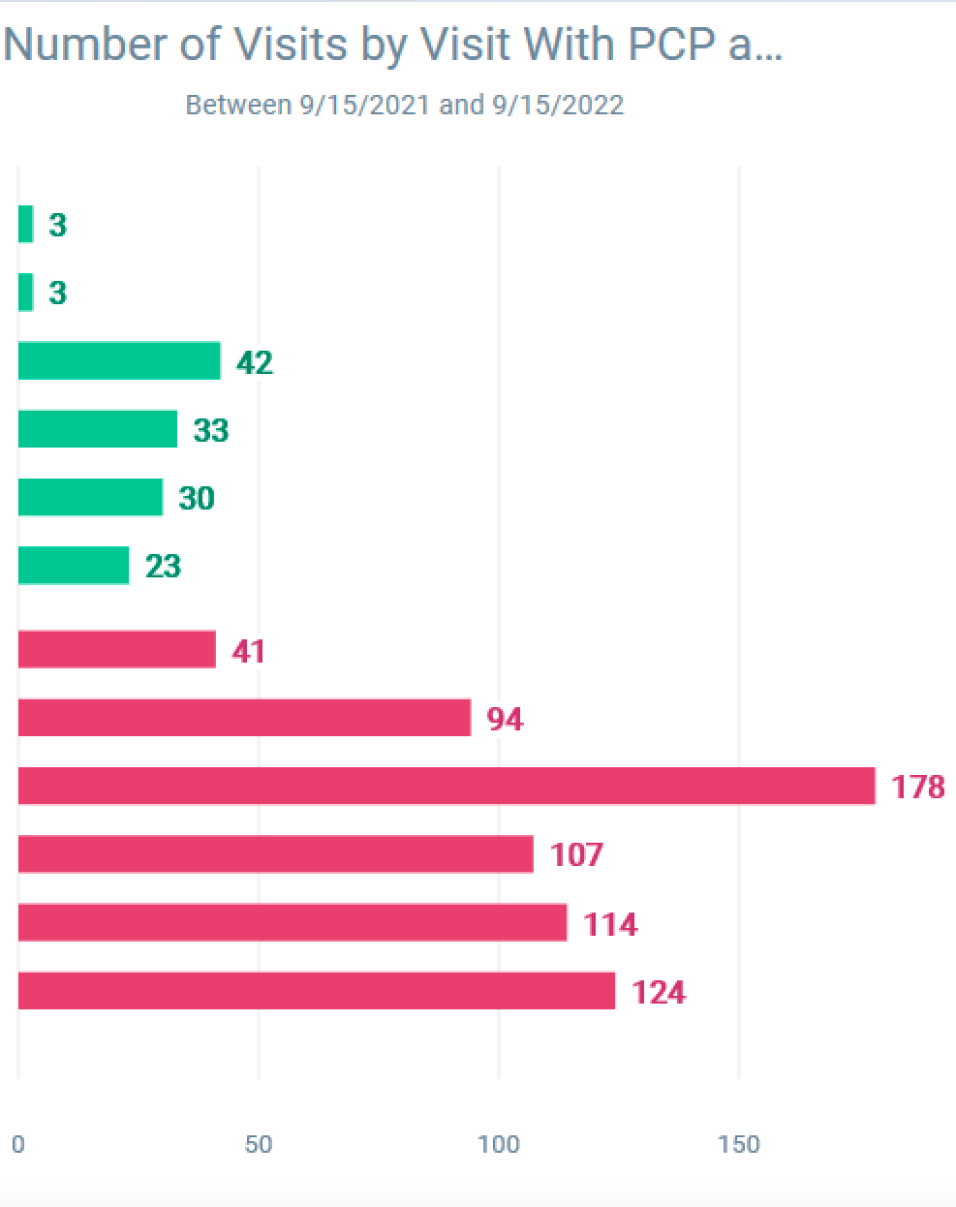
You Aren’t The Doctor I Saw Last Time: Improving Resident-Patient Continuity in an EM-IM Resident Clinic
Zachary Davidson, MD¹ Travis Olives, MD¹
Hennepin Healthcare¹ | Minneapolis, Minnesota
Quality Issue
Improving resident clinic continuity remains a challenge, however increased continuity (patients seeing the same provider each visit) is associated with increased physician and patient satisfaction^{1, 2} Our aim was to increase continuity with patients and their assigned resident PCP in the EM-IM program at Hennepin Healthcare by 40%. For the purposes of our analysis, the same set of 6 residents was followed, as PGY5 residents do not have outpatient clinic in our program
Effects of Change
After a multi-faceted intervention promoting scheduling for assigned PCP patients on the same half day of clinic residents saw visits with their PCP patients increase by 44%, this effect was most pronounced in more junior residents (PGY2-3) who averaged a 58% increase in visits with their continuity patients. We will note that a confounder may be that the total number of visits across residents also increased overall, primarily in the junior (PGY2-3) residents. Continuity remained low for PGY4 residents.
Lessons Learned
Resident EPIC education on clinic open-slots, and promoting team based care were high-yield interventions to promote visit continuity Continuity was lowest for PGY4 residents
Pre-intervention
Post-intervention
Between 9/15/20- 9/15/2021
Between 9/15/21- 9/15/2022
PGY3
PGY4
PGY3’
PGY4’
PGY2
PGY3
PGY2’
PGY3’
PGY1
PGY2
Maintenance
Continued communication between program and scheduling staff continues to be helpful Promoting patients scheduling their own appointments and exercising accountability for patients to call to cancel if they cannot make an upcoming appointment are future opportunities
Improvement Measure
Number of clinic visits between EM-IM residents and their PCP patients (indicated in EPIC EMR)
PGY1’
PGY2'
PGY3
PGY4
PGY3’
PGY4’
PGY2
PGY3
PGY2’
PGY3’
Test of Change
Meeting with the clinic medical director and clinic schedulers to discuss improving continuity Schedulers prioritize EM-IM panel patients scheduled on same day Met with residents to discuss project and promote ‘buy-in’ 30 minute didactic given to junior residents on scheduling own patients in Epic ‘open slots’ Increased clinic visits for residents on outpatient and additional blocks Residents pool clinic forms (MVNA, DME) and complete each-others when in clinic, contributing to team based care and collective ownership
PGY1
PGY2
PGY1’
PGY2’
Number of Resident clinic visits with PCP patients and Non-PCP patients
References
Saultz JW, Lochner J. Interpersonal continuity of care and care outcomes: a critical review. Ann Fam Med. 2005;3(2):159–166.). Linzer M, Poplau S, Grossman E, Varkey A, Yale S, Williams E, Hicks L, Brown RL, Wallock J, Kohnhorst D, Barbouche M. A Cluster Randomized Trial of Interventions to Improve Work Conditions and Clinician Burnout in Primary Care: Results from the Healthy Work Place (HWP) Study. J Gen Intern Med. 2015 Aug;30(8):1105-11. doi: 10.1007/s11606-015-3235-4. Epub 2015 Feb 28. PMID: 25724571; PMCID: PMC4510236. Srinivasan, Ranjini MD*; Sambatakos, Peter MD*; Lane, Mariellen MD*; Krishnan, Usha MD*; Weller, Rachel MD*; Flyer, Jonathan N. MD*,†; Robinson, Keith MD†; Glickstein, Julie MD*. Successful Increase of Outpatient Clinic Continuity in a Fellowship Quality Improvement Project. Pediatric Quality and Safety 5(3):p e306, May/June 2020. | DOI: 10.1097/pq9.0000000000000306

