Slide 1
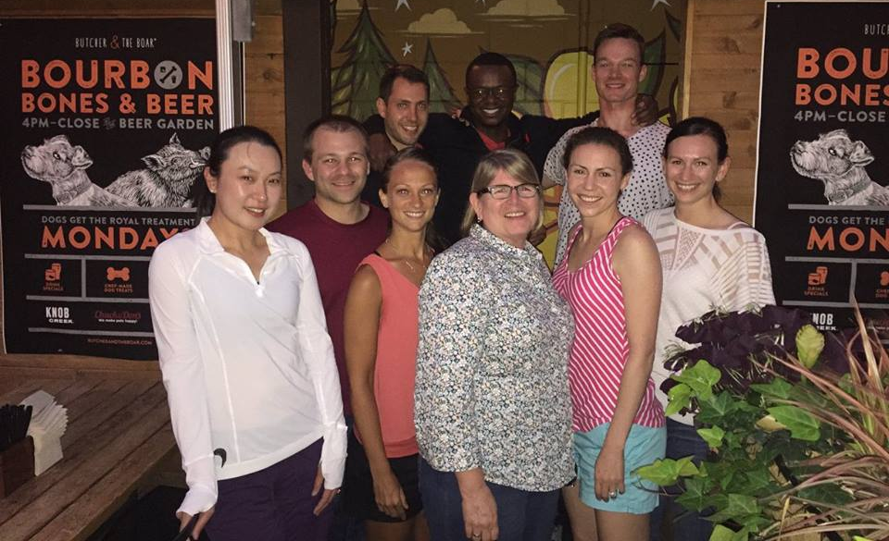
Own Our Own
Orthopaedic Surgery Residents • Class of 2016
Notes:
Thank you
Thank panel
I am the Ortho….

Slide 2
GME Coordinator/administrator: is it a bird, a plane, a job or a career?
Notes:
First came in 2008
The conference today did not exist back then

Slide 3
Kathy (Miller)Mainhart , B.S., C-TAGME, Johns Hopkins University
9th Annual Meeting • San Francisco, CA • 2012
What are the characteristics of a job vs. a career?
What factors influence individual choice?
For coordinators/administrators, is GME a job or a career?
Notes:
The department invested in me
ARCOS 2002 – one of the more established specialty group
Kathy Mainhart formerly OSD Johns Hopkins
Involved in 2011 survey Ped/Ortho
Job vs Career

Slide 4
Short Term Long Term
From Short-term To Long-term
More fulfilling/challenging than expected
Possibility of career path beyond coordinator position
Current economy has increased value of job security
2011 Survey of Peds and Ortho coordinators
Kathy (Miller) Mainhart – Johns Hopkins
Notes:
How did coordinators take a long term perspective with position?

Slide 5
Short Term Long Term
From Long-term To Short-term
Lack of opportunity for advancement
Coordinator position not valued / recognized
Program location change / institutional restructuring
Overwhelming amount of compliance / paperwork
Burnout??
2011 Survey of Peds and Ortho coordinators
Kathy (Miller) Mainhart – Johns Hopkins
Notes:
What made them feel a position was more of a job

Slide 6
Notes:
Exceptional advocate, founder of TAGME
Made career – presented, published, retired
My few minutes here are based on her message about professional development

Slide 7
Notes:
You have to own your own
No one else is going to give it to you
It’s all up to you Baby

Slide 8
Where do we want to go?

Slide 9
What Direction?
Horizontal Growth
Vertical Growth, Advancement
Gain Knowledge
Deliver quality product/service
Professionalism
Interpersonal Communications
Practice-based Learning & Improvement
System-based Practice & Improvement
Teach what I know to others
Look for opportunity to use skills in new way
Position myself to make more money
Do I need advance degree to move up – what are they really looking for?
Reach for challenges that I can grow into
Risk Factor
Notes:
Growth / Advancement
Young coordinator, learning, becoming more proficient

Slide 10
Notes:
Factors that shape how we balance personal with professional
No one is the same; influenced differently

Slide 11
Notes:
I work at the University of Minnesota since 2008

Slide 12
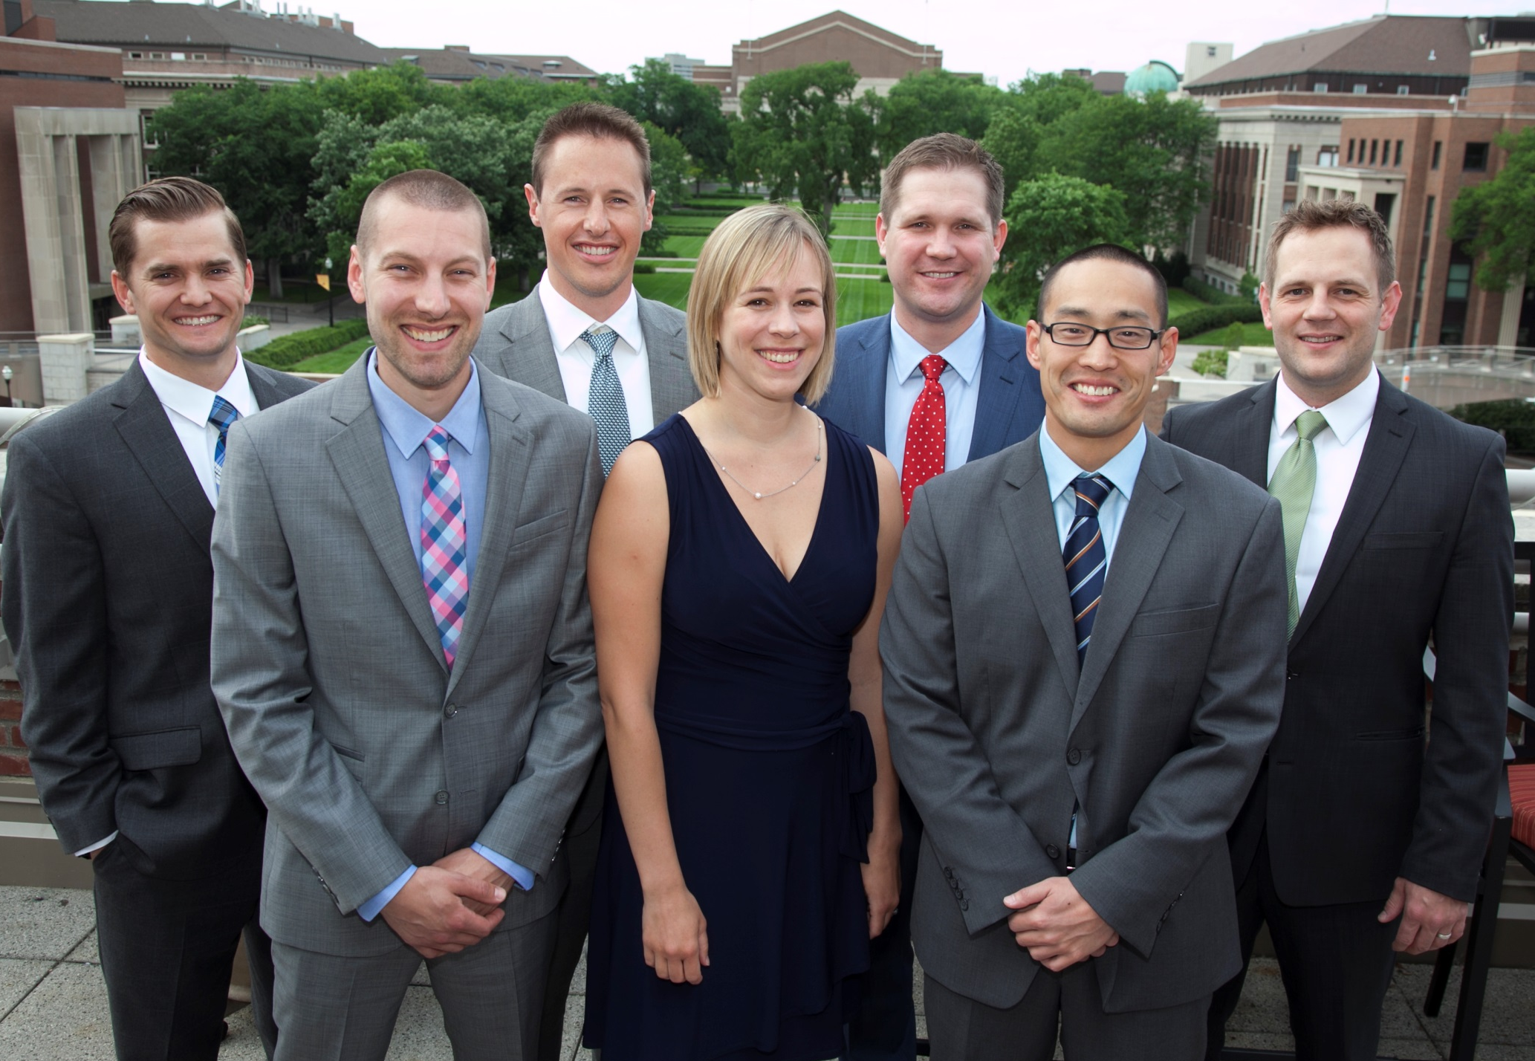
Class of 2015
Notes:
Marketing of Driven to Discover
Energizing
Motivational

Slide 13
Accountability
Compact between me and the University
University expects from me
I expect the University to allow me to challenge, develop, and excel professionally
Notes:
Accountability not just for me, but in order to discover, I need to be supported.

Slide 14
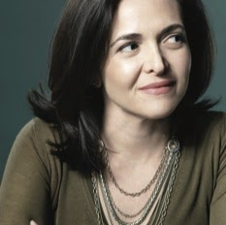
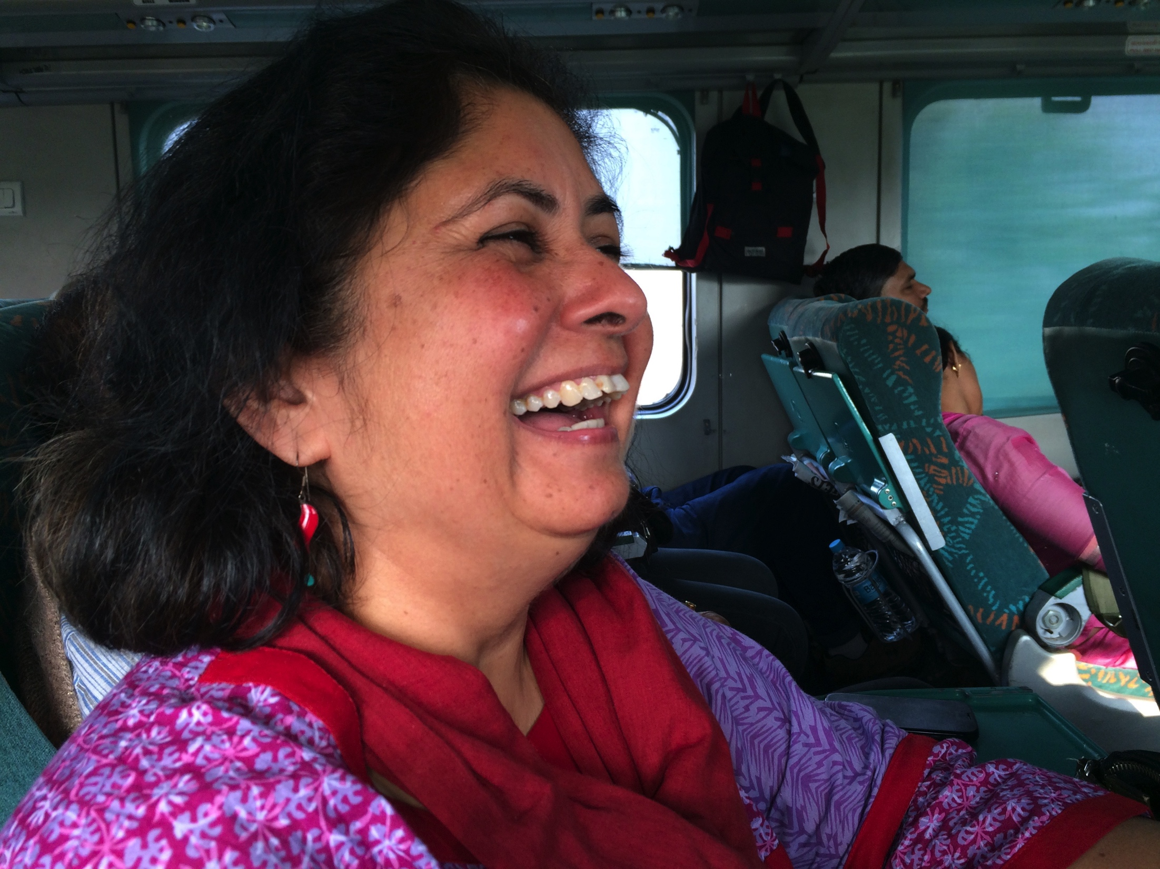
What am I worth?
LEAN IN movement
Sheryl Stanberg
Find advocates for my own professional growth
Become a stronger advocate for myself
Establish “protected time”
= I will do
Professor on train to Orchha

Slide 15
Opportunity for growth
Professional Development

Slide 16
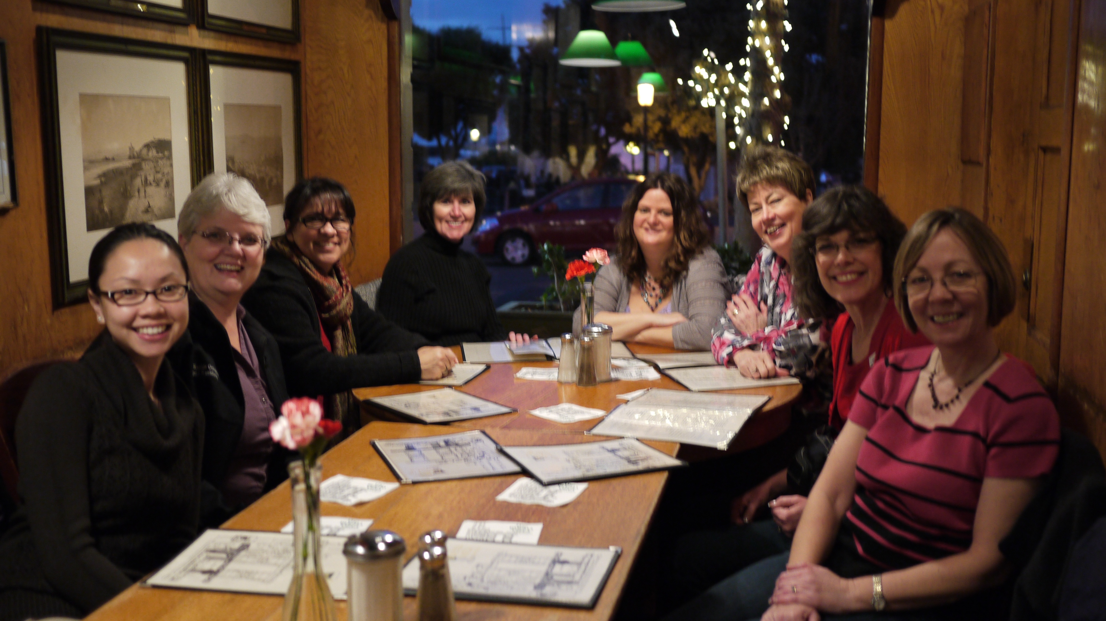
Table Conversations
ARCOS Annual Meeting, San Francisco

Slide 17
Possible Talking Points
Your CV
Owning Your Own
How can your CV best represent you, and what could you do to enhance/beef up your CV?
If your CV were your promotional manager, would you hire it or fire it for defamation of character? How well does it represent you?
What potential do you have for horizontal and/or vertical growth?
How does balancing your personal and professional affect your current position?
What is a way you have been able to advocate for yourself?
What resources can you access to enhance your professional development?

