Slide 1
A Journey to Quality Improvement
Benjamin Webber, MD
Senior Medical Director, Adult Med/Surg UMMC East Bank
Associate Vice Chair of Clinical Affairs, Department of Medicine
Notes:
Good evening everyone. Thank you so much for having me tonight.
My name is Ben Webber. I am a hospitalist at the University of Minnesota Medical Center. I am the Senior Medical Director of the Adult Med/Surg Units on the East Bank and also serve as the Associate Vice Chair of Clinical Affairs for the Department of Medicine.
I want to thank everyone that helped contribute to putting on this wonderful event. It is so great to see the enthusiasm and engagement by all of you. These are truly great projects and I’m excited for the future of medicine.

Slide 2
Disclosure Statement
I have no financial disclosures.
I will not discuss off label use and/or investigational use in this presentation.
Notes:
I have no financial disclosures and won’t be discussing any off-label investigational drugs or tools.

Slide 3
Journey before Destination…
- Brandon Sanderson
Notes:
So I am a huge science fiction and fantasy nerd and one of my favorite authors is Brandon Sanderson, he’s written some really excellent books and series that all happen in the same universe “The Cosmere”. I could probably talk all day about his books and the worlds he creates but I really just want to focus on this one quote. If anyone is wondering its part of an oath by the Knight’s Radiant.
Journey before destination. This resonates a lot with me and so I am going to talk about the journey I’ve taken to be here today, standing in front of you all talking about quality and patient safety. And spoiler alert, if you asked me 10 years ago where my career in Medicine was headed, I would not have said being here.

Slide 4
I want to help people!
- Me, age 5
Notes:
I think it is engrained in all of us, from a very early age, the desire to help people. To heal the sick…to cure the ill…and to soothe the suffering.
I would wager to guess that a lot of us in this room right now said this at one point when asked about becoming a doctor. I know I did. Almost as long as I can remember I wanted to be a doctor. There was a short period before that though that marine biologist was at the top of my list…

Slide 5
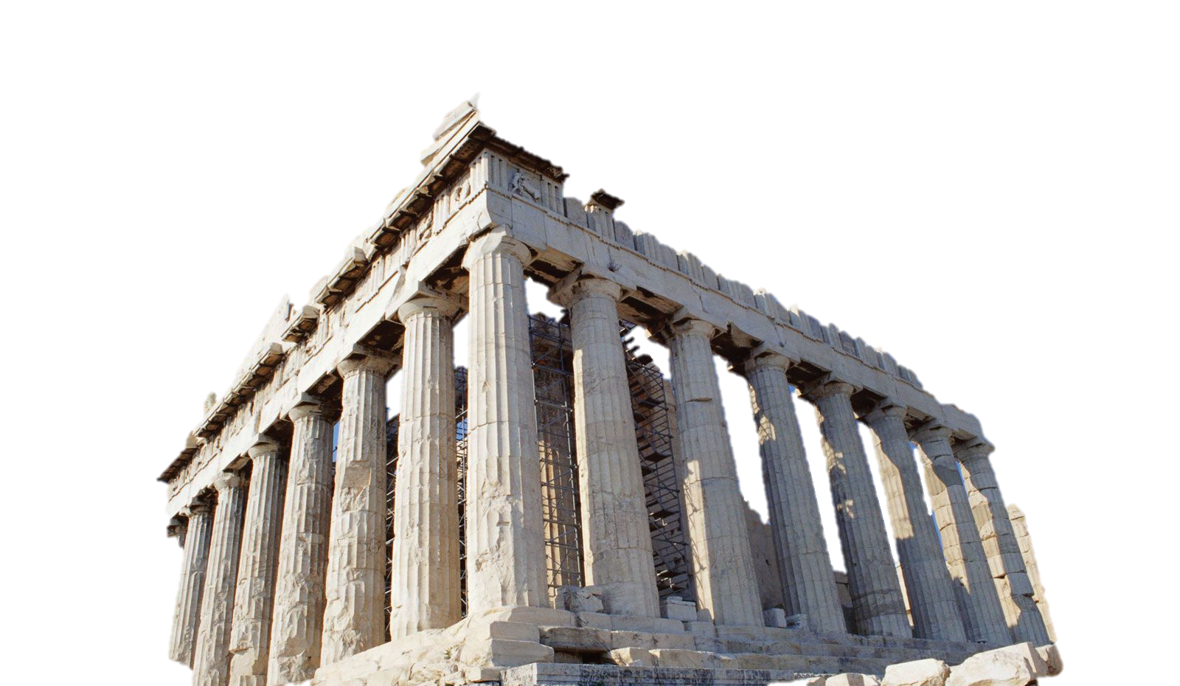
Notes:
But, by the time I went to college I knew I definitely wanted to be a doctor.
Growing up in Massachusetts and being a bit of a home body, I ended up going to the College of the Holy Cross in Worcester MA.
At the time, to get into the pre-med concentration you needed to apply BEFORE you got into the school. I didn’t know that, so my pre-med classes were all delayed a year.
So instead of being a science major, I was a Classics major. I studied Latin and Greek. I figured Hippocrates was Greek right? And physicians love him. Truthfully though, I enjoyed it, found it interesting, and figured I would spend the rest of my life doing science and medicine so why not study something else?
Eventually though I made it into the pre-med concentration and got all my required classes.

Slide 6
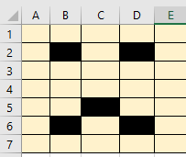
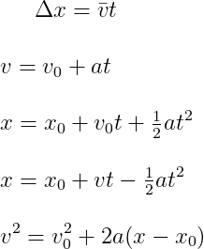
b
a
c
Notes:
As I mentioned, my pre-med classes were all delayed a year which meant I couldn’t apply to medical school immediately out of college. Instead, I took a job as a data manager in the Division of Radiation Oncology at the Brigham and Women’s Hospital.
My primary role was to manage a database for a study that screened for secondary malignancies in Hodgkin’s Disease survivors. During my time here I learned a few things. One, I am not very good at Excel. To get around Excel I set up a form to input data into that would then push it to excel. I was improving my process.
Second, Radiation Oncology was way too much physics for my liking.
Case in point, I have no idea what these equations mean but they came up when I googled physics equations.

Slide 7
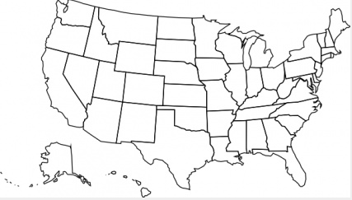
?
Notes:
After a year I could finally apply to medical school. My dreams were finally going to come true.
I addition to every medical school in Massachusetts and New England I also applied to schools in Illinois, Missouri, Lousiana, Virginia, New York, Pennyslvania, DC. All over. Except Minnesota, I wasn’t really sure where that was yet…
I anxiously awaited to hear back for all the interviews I was going to get.

Slide 8
X
Notes:
AND… I didn’t get into any of them.

Slide 9
?
Notes:
So what did I do?
I applied again. To even more schools. If the outcome wasn’t the desired one, just repeat the process right? Well not exactly. I had bolstered my resume a bit, spent another year at Brigham and Women’s, refined my application, wrote more essays. I was doing my own form of process improvement to achieve a better outcome.
Still wasn’t sure where Minnesota was though…

Slide 10
Notes:
AND…I got in! To ONE school!
I got into Loyola University Stritch School of Medicine. I was headed to Chicago
But true story…I actually had a classmate with the same name spelled differently. For a long time I was convinced that they meant to accept him (he was very very smart). And then felt bad about rescinding my acceptance so they were stuck with me.
Truthfully, Its contributed to my imposter syndrome. I’m just waiting for someone to come around a corner and say Hey! You’re not the right Ben!

Slide 11
Notes:
I loved Loyola. I had an amazing time.
But I struggled. I am NOT a good test taker. I scored below average on Step One. So what, I thought, my skills lay elsewhere.
And so I excelled in my clerkships. Not ALL of them, mind you. Surgery wasn’t my cup of tea. But I really enjoyed all my other clerkships and made the decision to go into Internal Medicine. I saw my destination as a Pulmonary/Critical Care physician like one of my mentors at Loyola. My journey had other ideas.
After 4 years of medical school, I ended up being in the bottom third of my class. I thought, not for the first time, that I was destined never to reach my goals.
But it wasn’t all bad. In medical school. I met my wife. Before we married, we decided to couple’s match. We applied all over the country but really honed in on two locations. New England where I was from, and Minnesota, where she grew up.
Match day came and we got our first choice!

Slide 12
Quality Improvement enters the chat…
Notes:
We matched at the University of Minnesota. I matched in Internal Medicine and she matched in Anesthesiology.
I finally felt like I had made it. I loved residency. I loved taking care of my patients. I loved rotating through different specialties.
I still had my sights set on Pulmonary and Critical Care but was enjoying just being a resident.
It was in my VA Primary Care Clinic that I first was exposed to Quality Improvement.

Slide 13
Alex
Bill
Scott
Kenneth
Dorothy
Meghan
Charles
Edgar
Arthur
Elizabeth
Ryan
Cindy
Jordyn
Jack
Janet
Margaret
Brian
Melissa
Keith
Jimmy
Kevin
Jack
Rachel
Hannah
Notes:
As you probably know and many of you have experienced, the residency program has as a requirement that you participate in a Quality Improvement project during your 3-years.
I wasn’t terribly thrilled about it. I was going to be a Pulmonary Critical Care doctor who took care of the sickest of the sick. I was going to leave the quality improvement to quality improvement people.
The project we landed on as a group was to reduce long term PPI usage in patients without a clear indication. Each resident got a long list of all their patients who were on a PPI.
When a patient came into clinic for any reason, we had a conversation with them about the long term consequences of PPI usage, increased infection risk, osteoporosis, etc. And tried to get come off the medication.
Now, I come from a family of veterans. Both my grandparents were veterans. My brother is a veteran. And if you know veterans, they are not easy to convince.

Slide 14
Alex
Bill
Scott
Kenneth
Dorothy
Meghan
Charles
Edgar
Arthur
Elizabeth
Ryan
Cindy
Jordyn
Jack
Janet
Margaret
Brian
Melissa
Keith
Jimmy
Kevin
Jack
Rachel
Hannah
Notes:
So we methodically went down the list and checked off or crossed off patients who we were able to get off of the PPIs.
Thrilling stuff, I know.
After the project, I certainly wasn’t convinced that Quality Improvement was the stuff for me but I did see start to see the impact it could have.
We were able to make a realistic difference and reduced potential harm to our patients. Not to mention, a lot of patients were excited about the idea of taking fewer medications.

Slide 15
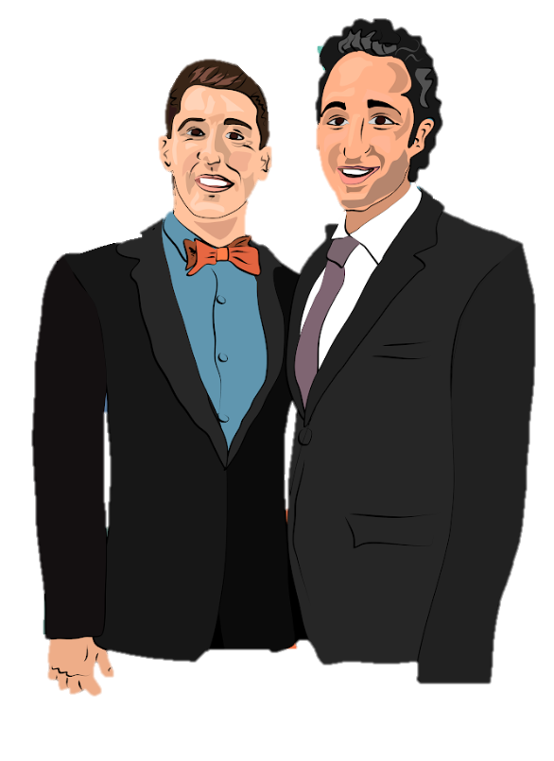
We want to help residents!
Notes:
Fast forward a few years and I was selected as one of the Chief Residents for the University site. This is my co-chief Demetri. My cousin designed this cartoon of us so we could put it on Christmas mugs and give them out as gifts.
But anyway, Demetri and I were thrilled. We had so many ideas and things that were going to be improved. The residents were going to be so lucky to have us as Chiefs.

Slide 16
Notes:
Now it was around this time that Sepsis care at the University Medical Center was really taking off. I may have heard some groans in the room as some of you may be familiar with this.
We had started was affectionately called the Lactate Protocol. Essentially, a patient would meet 2 out of 4 modified SIRS criteria, EPIC would alert the RN to order a lactate, and if the lactate came back positive or greater than 2, the provider team would be called and they would come to the bedside to assess the patient for possible sepsis.
Seems pretty straight forward.
Well, everyone hated it. Residents especially. It could really interfere with the flow of your day…

Slide 17
What was required…
See the patient within 30 minutes (or 10 if lactate > 4)
Utilize the Sepsis Order Set
Write a Sepsis Evaluation Note
Notes:
You had to drop what you were doing and go see the patient immediately.
You had to use a specifically designed order set and then write an evaluation note.
It was disruptive to say the least.

Slide 18
Sepsis BPA Compliance
Notes:
And our compliance with the process reflected how much people hated it. We consistently hovered around the 50% range, dipping as low as 19% in one month but never as high as 70%.

Slide 19
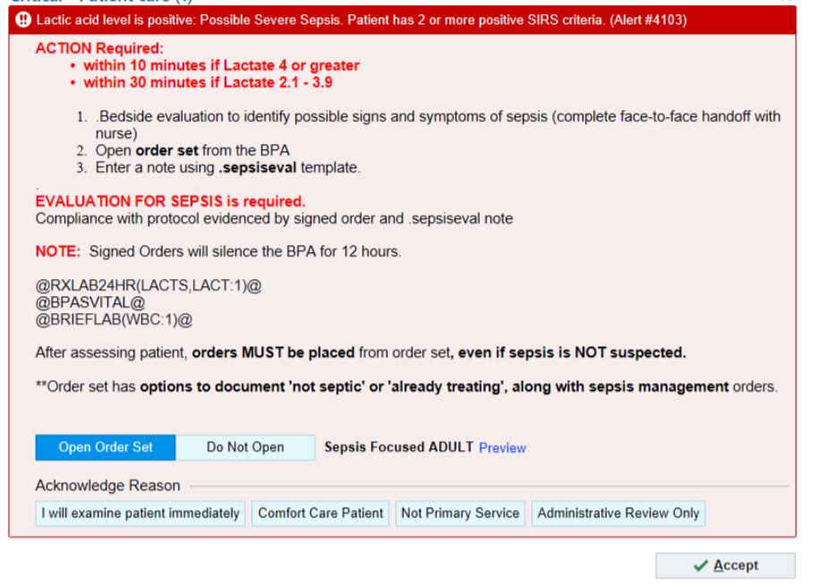
Notes:
It was during my chief year that I was asked to join the UMMC Sepsis Committee. The aim of the group was to improve sepsis care at the University through things like the Sepsis Best Practice Alert.
The committee was made up of a lot of important people with lots of letters and acronyms after their names. I actually had to google a few to figure out what their actual job was. CMO. Associate CMO. QIC. EPMO. The committee was made up of all different specialties too. It was led by and Ob/Gyn. There was a critical care doc, an infectious diseases physician, a couple of surgeons, and a hospitalist. I was to be the resident representative.
To be honest, at first I didn’t say much. I was a little bit intimidated by all the big names. But pretty quickly I realized that I had THE MOST experience with the process. The BPA didn’t fire in the ICU. Consultants weren’t expected to respond. It certainly didn’t alert in the operating room. And as I’m sure you are all aware, attendings didn’t actually do any work so it always fell to the residents anyways.
I threw myself head first into improving the process for residents and hopefully in turn our outcomes.
It was also around this time that something funny started to happen. My goals started to shift. I was a Chief Resident working on a quality and patient safety/improvement committee. I was attending for a few weeks out of the year. And I was felt fulfilled. I started to doubt whether I needed to be a Pulmonary/Critical Care physician to have a meaningful career in medicine.

Slide 20
Sepsis BPA Compliance at UMMC after August 2020
Notes:
Soon my time as a Chief was over. By this time I had made the decision to forego fellowship and become a hospitalist. I still wasn’t sure where my ultimate destination would be in my career, but I felt confident that it didn’t HAVE to be as a specialist.
I was still in the Sepsis Committee, now as the lead Hospitalist. Together, with a few other physicians, we developed a grant to help streamline the process and got the support of the University and Medical Center. Instead of trying to educate everyone at UMMC about what needed to happen for every fire of the BPA. We inserted an APP into the rapid response team and mandated that they respond to the BPA.
Pretty soon, our compliance went from 40-50% to consistently above the 90%.

Slide 21
I want to help people!
- Me, age 5
Notes:
I started to see the impact that quality, safety, and process improvement could have. And how fulfilling it could be as part of a career.
My thinking shifted from “I want to help people!” at Age 5
To

Slide 22
I want to help the most people!
- Me, age 35
Notes:
I want to help the MOST people at age 35.
And to that end I had a bit of an epiphany.
Now I realize that I am currently surrounded by brilliant people doing amazing work that will go on to help a lot of people.

Slide 23
Notes:
But I also know, that I am not going to develop a vaccine to protect people from the next pandemic. I will not create the next cancer drug that eradicates malignancy. I am not going to discover a protein that can combat dementia.
But what I CAN do is try to make the hospital I work in, the safest, highest quality, hospital I can.

Slide 24
5B
5B
6B
5A
5B
6B
7B
Notes:
So when an opening on a few of the Med/Surg units opened up, I know I wanted to apply. This was my chance to make an impact on the entire unit.
I got the job. And this time, that other Ben Webber from Loyola wasn’t around.
After becoming medical director of 5B, I was asked to take over 6B as well. Then they went to a senior medical director model and I was chosen to serve as Senior Medical Director of all the Med/Surg units on the East Bank.

Slide 25
Teamwork makes the dream work…
Reduced HAI
Reduced LOS
Reduced
Sepsis
O/E
Started Inpatient
Hospice
HFNC
On
MedSurg
Notes:
And as Senior Medical Director, I have participated on some absolutely fantastic teams and accomplished a lot.
We reduced hospital acquired infections. It has been greater than 1 year since the last hospital acquired c diff infection on 5B.
We have rolled out an inpatient hospice program that has significantly reduced overall mortality at UMMC and the system.
We have reduced overall length of stay for inpatients.
We rolled out High Flow Nasal Cannula on all med/surg units.
We reduced Sepsis O/E mortality and improved CMS compliance
And many many many other smaller projects across the units.

Slide 26
Ikigai
What you love.
PASSION
MISSION
What you are good at.
What the world needs.
IKIGAI
PROFESSION
VOCATION
What you get paid for.
Notes:
So how do I feel now? What is a good quality improvement/process improvement talk without a venn diagram?
I really like this diagram. In the blue, we have “what you love”, in the Green “what the world needs”. The orange, “what you get paid for” and the yellow, What you’re good at.
Going around, where the blue and green intersect we have your mission. Something the world needs and something that you love. Your vocation is at the intersection of what the world needs and what you get paid for. You profession is what you’re good at and what you get paid for. And finally, your passion is what you love and what you’re good at.
The intersection of all those circles is ikigai. A Japanese term for “reason for being”
Now unfortunately, my ikigai can’t be playing quarterback for the New England Patriots. I like Mac Jones but I think they could use one. My ikigai has become quality improvement….with some tweaks.

Slide 27
What you care about.
What you are willing to work on.
What the
hospital
needs.
IKIGAI
What you get paid for.
Notes:
What you love becomes what you care about
What the world needs, becomes what your hospital or system needs.
We can keep what you get paid for. I have no illusions about free labor.
And finally, what you’re good at becomes what you’re willing to work on.
And because this is a Quality Forum, I know you all care about patient’s, I know you’re doing the work that hospitals need, you might not be getting paid for your QI work yet, but hopefully someday, and I know you all are willing to work at this just by you being here.

Slide 28
Journey before Destination…
- Brandon Sanderson
Notes:
Journey before destination.
I actually see a lot of parallels between my career and to QI and process improvement itself. Quality and process improvement is all about assessing outcomes and tweaking or changing the process to get better results. Excel wasn’t working for me, I didn’t get into medical school the first time around, the elevated lactate protocol was failing, but with some added insight, small changes make a big difference.
So find what you care about, what you’re willing to work on, and take some chances. Apply to that job, volunteer for the project. You never know where your journey will take you.

Slide 29
Thank You! Questions?

