Slide 1
Using Non-Primary Rotations in RMS
RMS Spotlight – March 2024
UMN GME Program Coordinators Meeting
Featured by MMCGME Services

Slide 2
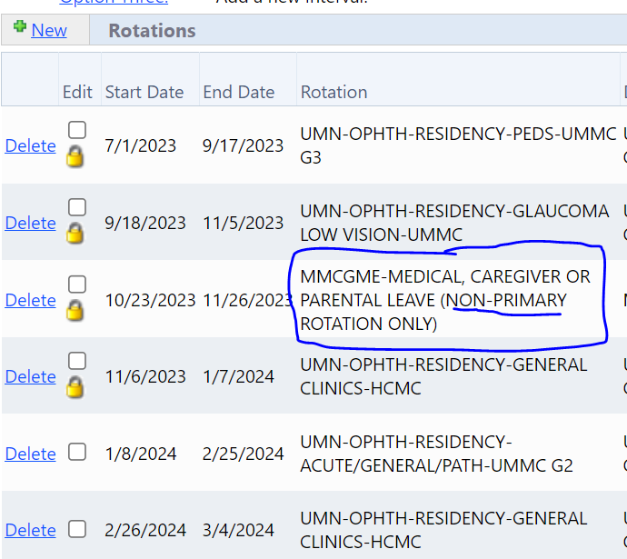
Non-Primary Rotations
Secondary rotations
Can be used for tracking non-extending time away for the programs
There must be a primary rotation covering this time in block schedule
Primary checkbox = UNCHECKED

Slide 3
MMCGME Non-Primary Rotations

Slide 4
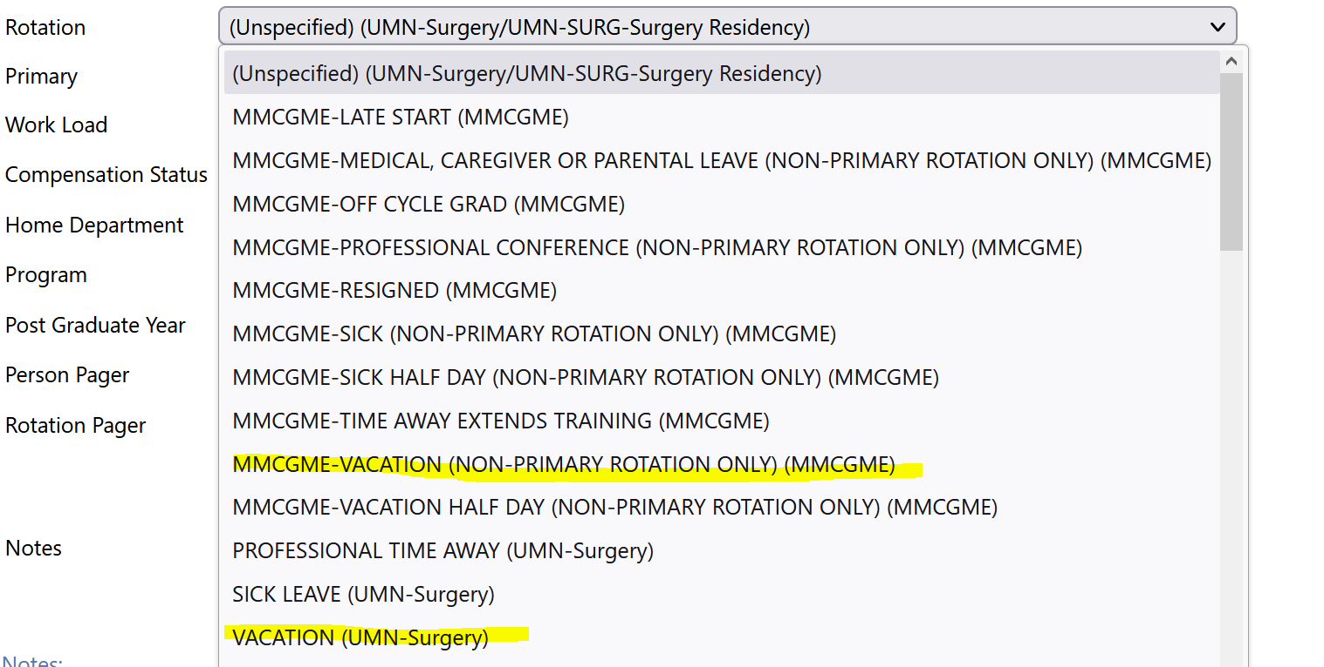
Program-Specific Non-Primary Rotations
Programs are allowed to use their own Department/Program non-primary rotations
PROFESSIONAL TIME AWAY (UMN-Surgery)
SICK LEAVE (UMN-Surgery)
VACATION (UMN-Surgery)

Slide 5
Questions?
https://www.mmcgmeservices.org
Training – Training Materials – Block Schedule Training Manual (pgs. 12-13)
Email: MMCGMEhelp@umn.edu

