Slide 1
RMS Resident Training - 2019
Notes:
Welcome to RMS resident training.
This training takes about 30 minutes in length and covers why RMS is used and how it works. At the end of the training, you will be given a chance to log your time and ask any questions you have about this process.

Slide 2
Objectives
Learn why work hours are logged in RMS
Review current ACGME work hour regulations
Understand your role/responsibilities in using RMS to record and approve your duty hours
Know who to go to in your program for support
Learn tips for logging hours to prevent violations
How your program utilizes the optional RMS modules
Notes:
This training is designed to teach you how to use RMS. The objectives for this training are:
Learn why work hours are entered in RMS
Review the ACGME workhour rules that went into effect July 1, 2017.
Understand your role and responsibilities in using RMS to record and approve your work hours
Know who to contact if you need help using RMS
Learn tips and tricks for logging your hours to prevent work hour violations.

Slide 3
Tracking Work Hours: Why?
Why is it important to track my work hours?
Monitoring ACGME work hour violations
Program management of rotations/locations in relation to violations
Notes:
Tracking your work hours (also called duty hours) is important to our program for a couple reasons:
1. Our program and sponsoring institution are both responsible for monitoring work hours to make sure your workload is manageable and if there are any problems with violations, they are being addressed.
2. By accurately tracking your hours, you can help identify locations or particular rotations that are a source of frequent violations and help us to make necessary changes.
On the next slides, we will go into more detail about each of these three things.

Slide 4
Tracking Work Hours: ACGME Rules
In addition to reimbursement, tracking your time helps your program and institution monitor ACGME work hour rules and violations.
Work hour tracking is required for accreditation
It helps ensure both patient and resident/fellow safety
Allows your program/institution the ability to monitor problematic sites & rotations and to make changes
Allows YOU better management of your time by seeing violations and adjusting your schedule to prevent them
Notes:
Aside from reimbursement, entering your time is important to help our program and institution track Work Hour rule violations. Tracking work hour violations is a requirement for our program accreditation and it is important to ensure both you and your patients’ safety. <Discuss how your program tracks violations and what is done with the information.>
In addition, when we see patterns or violations that occur frequently for a particular site or rotation, we can use these to discuss what is happening with the site and come up with ways to minimize the violations by shifting workloads or altering services.
Finally, the ability for you to see violations when you are entering your time should also allow you to better manage your schedule, making adjustments as necessary to try and prevent violations. For example, if you end up working late one night and you know you will be violating a rule by not having enough time off, you should work with your supervisor and co-workers to arrange coming in late the next morning.

Slide 5
ACGME Rules
Effective July 1, 2017
Notes:
The ACGME – the council that oversees most accredited graduate medical education programs in the US – sets rules for accreditation of programs. With recent changes to the rules, we frequently monitor your duty hours so that our program can make changes, if needed, to ensure these standards are met.
NOTE: If your program’s accrediting body is not the ACGME, update this slide with the correct information.

Slide 6
Work Hour Tracking - Rules
ACGME work hour rules that programs are responsible for are following:
Maximum 80 Hour Work Week (Averaged Over 4 weeks)
  Clinical and educational work hours must be limited to no more than 80 hours per week, averaged over a four-week period, inclusive of all in-house clinical and educational activities, clinical work done from home, and all moonlighting.
Notes:
NOTE: These are the standard rules outlined by ACGME. If your program follows slightly different rules, you will have to modify these slides so they are accurate for your program!
Here are the work hour rules (read off slide.)

Slide 7
Work Hour Tracking - Rules
Call Frequency:
  Trainees must be scheduled for in-house call no more frequently than every third night (when averaged over a four-week period).
  Time spent on patient care activities by trainees on at-home call must count toward the 80-hour maximum weekly limit. The frequency of at-home call is not subject to the every-third-night limitation, but must satisfy the requirement for one day in seven free of clinical work and education, when averaged over four weeks.

Slide 8
Work Hour Tracking - Rules
Maximum Hours:
  Clinical and educational work periods for trainees must not exceed 24 hours of continuous scheduled clinical assignments.
  Up to four hours of additional time may be used for activities related to patient safety, such as providing effective transitions of care, and/or trainee education.
Hours off between shifts:
  Trainees should have 8 hours off between scheduled clinical work and education periods
  Trainees must have 14 hours free of clinical work and education after 24 hours on duty

Slide 9
Work Hour Tracking - Rules
Day Off:
  Trainees must be scheduled for a minimum of one day in seven free of clinical work and required education (when averaged over four weeks). At-home call cannot be assigned on these free days.
Night Float:
  Night float must occur within the context of the 80-hour and one-day-off-in-seven requirements.
Moonlighting:
  Moonlighting must not interfere with the ability of the resident to achieve the goals and objectives of the educational program, and must not interfere with the trainee’s fitness for work nor compromise patient safety.

Slide 10
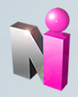
So, how do I track my hours?
Programs use a system called RMS to track work hours
RMS stands for “Residency Management Suite”
The RMS software was created by a company
located in Ohio called New Innovations
RMS is used by all accredited residency and fellowship programs in the Twin Cities area (including programs at Hennepin Healthcare, Regions, Allina, TRIA, and the U of M)
Notes:
Now that you know why it’s important to track your hours, it’s time to learn more about how to log them. Our program uses a system called RMS to track work hours for violation purposes.
You’re probably wondering what RMS is and what you need to do with it. RMS stands for Residency Management Suite and it’s an online product developed by a company called New Innovations (that’s located in Ohio.) Once you log into the system, there are many activities that can be done, including logging time. By logging your hours on the RMS website, this data is available to support the ACGME-related training requirements.
The same program is used by all residents and fellows in the Twin Cities to allow for consistent work hour reporting and tracking across the hospitals and programs involved. However, each program uses the system slightly differently so if you came from another program using RMS (or have friends in another program currently,) you may be doing slightly different things in the system.

Slide 11

Using the RMS System
Logging In
Home Page
Changing your Password
What to Log
What NOT to Log
How to Log Duty Hours
Duty Hour Violations
Tips and Tricks
Notes:
Now I’m going to demonstrate some activities within the program. For the first part of the demo, you can leave your machines off/closed so that I can show you some of the basics of using RMS. At the end of training, you will have a chance to practice in the system.
First, I’m going to talk about the steps to log in and how to navigate in the system. Then, we will cover how to log some of the different tasks you may be doing, and finally, you will be able to enter your time from Orientation/the first week of the program.

Slide 12

Logging in to RMS
Navigate to: www.new-innov.com
Click on the “Login” button
Notes:
***Demo – you may want to demo this for your residents/fellows rather than going through the slides (Hide this slide if doing a demo and switch to RMS): You can log in for the demo using your own login (be aware that you have more security than residents so you will see more options than they do.) Or, you can log in using a demo resident:
Department: MMCGME-Training Department
Username: aresident
Password: aresident
_________________________________________________
To get to RMS, you will go to www.new-innov.com and click on the “client login” button near the top. In general, it’s best to use Internet Explorer on a PC when you’re logging your time. Although some things work with Mozilla, Chrome, or other browsers, you’ll have the least amount of problems with IE.
If you ever have any trouble logging in, please contact your Program/RMS Coordinator for help. Try to gather as much information as possible about any error messages or other issues you receive so that we are able to investigate any problems.

Slide 13
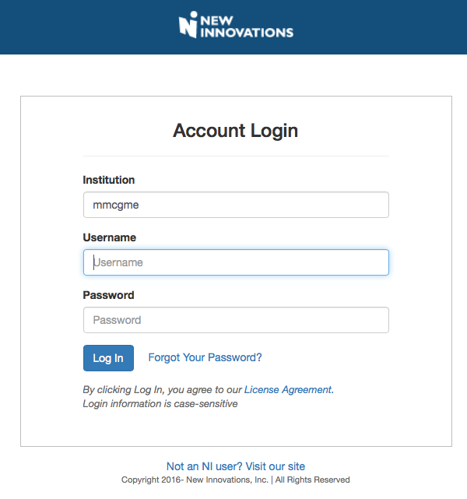
Enter Username and Password
Institution Login:
  mmcgme
Username and Password:
  First initial, last name (e.g., Jane Doe = jdoe)
  On the next screen, click “ Continue”
Notes:
After clicking submit, you will then be taken to the login page.
Now you’re ready to enter your username and password into the boxes. At the end of this training, I will be handing out a sheet with each of your usernames/passwords as well as the login information we just covered, but for now, you can just watch my as I log in.
Once you have entered your username and password, click on the “Log In” hyperlink to continue.
***Demo – you may want to demo this for your residents/fellows rather than going through the slides (Hide this slide if doing a demo and switch to RMS).

Slide 14
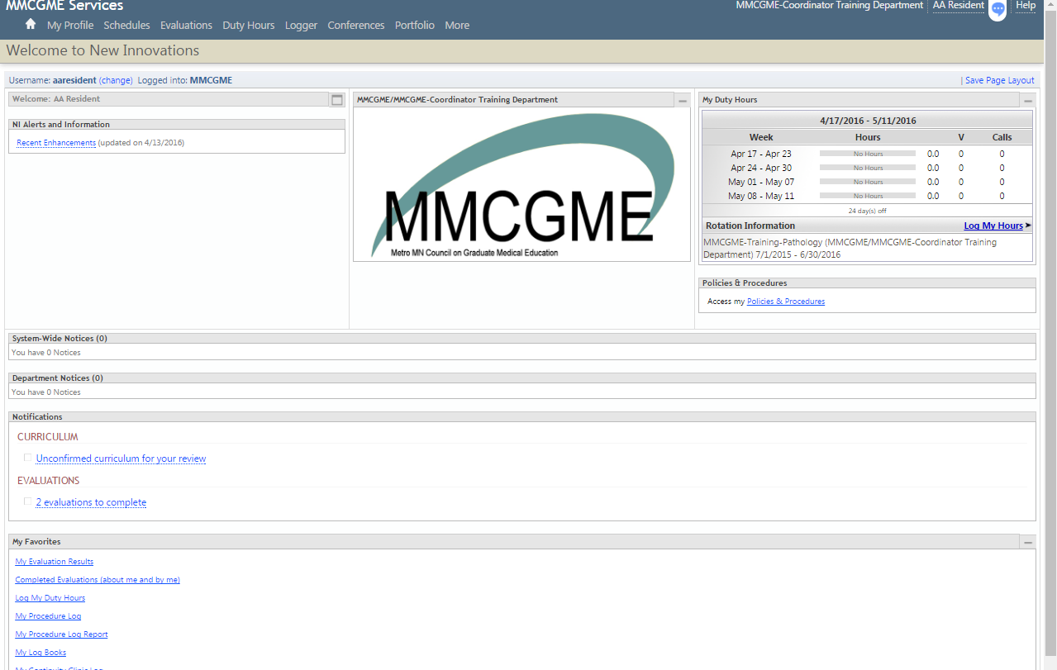
Home Page
After logging in, you will be directed to your Department Home Page which provides an overview of all your activity.
Notes:
After completing login, you will be directed to our Department Home Page. This page provides you with a quick snapshot of the department. If there are any department notices, they will appear here.
**Training Note: If your program uses the department home page, you may wish to point out forms (in Department Notices) or other relevant information that is stored here.
***Demo – you may want to demo this for your residents/fellows rather than going through the slides (Hide this slide if doing a demo and switch to RMS).

Slide 15
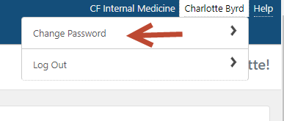
Change your password
Hover over your name on the top right of the screen
Select “Change Password”
Notes:
The resident/fellow password defaults to the first initial of their first name and full last name. Upon their initial login to RMS, they will be prompted to immediately change their password.
To change a password after the initial update, hover over your name and select Change Password.
Trainer Note: Instruction on how to verify resident/fellow usernames is included on page 6 of the facilitator guide distributed by MMCGME Service in conjunction with this PowerPoint.
***Demo – you may want to demo this for your residents/fellows rather than going through the slides (Hide this slide if doing a demo and switch to RMS).

Slide 16
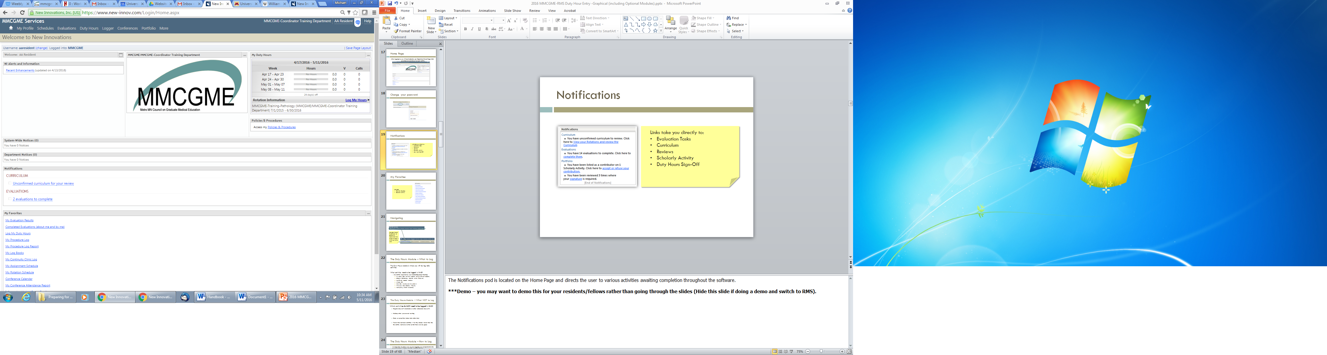
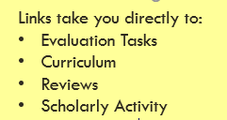
Notifications
Notes:
The Notifications pod is located on the Home Page and directs the user to various activities awaiting completion throughout the software.
***Demo – you may want to demo this for your residents/fellows rather than going through the slides (Hide this slide if doing a demo and switch to RMS).

Slide 17
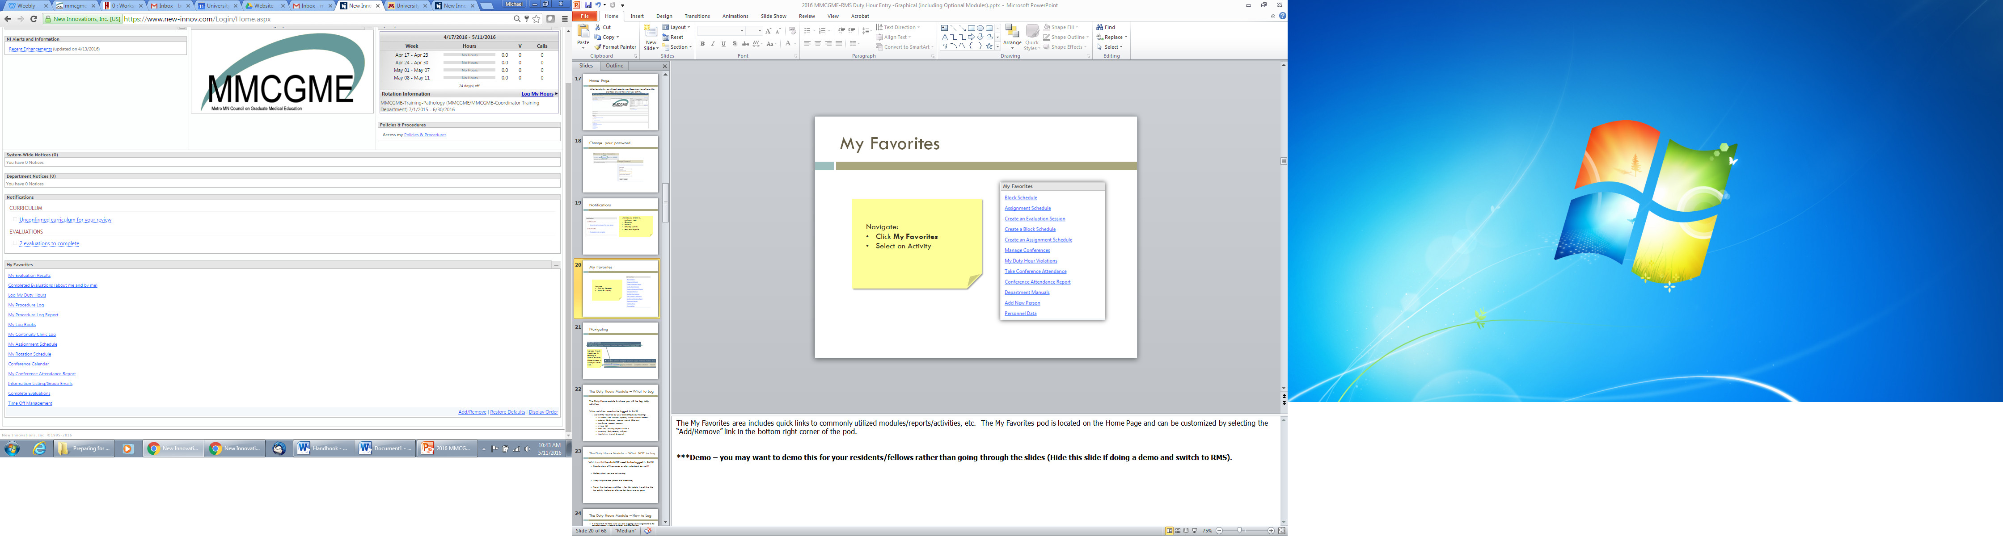
My Favorites
Navigate:
Click My Favorites
Select an Activity
Notes:
The My Favorites area includes quick links to commonly utilized modules/reports/activities, etc. The My Favorites pod is located on the Home Page and can be customized by selecting the “Add/Remove” link in the bottom right corner of the pod.
***Demo – you may want to demo this for your residents/fellows rather than going through the slides (Hide this slide if doing a demo and switch to RMS).

Slide 18
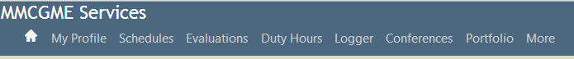
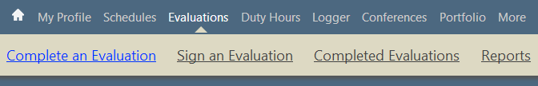
Navigating
Navigate through the software by selecting a Module and then choose the area in which you wish to work.
Notes:
You can navigate through the software by clicking on the Main menu bar and selecting the module you would like. Again, during this training, we are going to be focusing on the Duty Hours module so that’s what you will be selecting from the list.
***Demo – you may want to demo this for your residents/fellows rather than going through the slides (Hide this slide if doing a demo and switch to RMS).

Slide 19
The Duty Hours Module – What to Log
  The Duty Hours module is where you will be log daily work hours. Note: Depending on your program you may or may not be required to log hours. Please speak to your program coordinator about what you need to log.
  What work hours need to be logged in RMS?
    Any activity required by your accrediting body including:
      ALL Patient Care Activities (Inpatient, Clinics & Clinical Research)
      Didactics (Conferences, Required Journal Clubs, etc.)
      Non-Clinical Research Rotations
      In-House Call
      Home Call, including any time called in
      Time Away (Sick, Vacation, PTO, etc.)
      Moonlighting (Internal & External)
      Working at home
Notes:
The Duty Hours module is the place you go to log all of your daily work hours. There are things that NEED to be logged and then there are things that you DON’T NEED to log.
This slide shows the work hours that need to be logged. In general, anything that is required by the ACGME <your accrediting body> needs to be logged. These include:
Regular patient care-related activities including both inpatient and clinic time.
Any required didactics or learning-related classes that must be taken such as required conferences, journal clubs, M&M, etc.
Time that is spent doing research
In house and Home-call. We will discuss both of these in more detail later, but both of them must be logged in RMS.
Finally, any time away that you take including sick leave, vacation, other PTO, etc.
If you have any questions about what needs to be logged, please ask your program coordinator.

Slide 20
The Duty Hours Module – What NOT to Log
  Which activities do NOT need to be logged in RMS?
    Regular days off (weekends or other scheduled days off)
    Holidays that you are not working
    Study or prep time (unless told otherwise)
    Travel time between activities – for this, include travel time into the activity before or after so that there are no gaps
Notes:
Now, let’s look at what doesn’t need to be logged in Duty Hours.
Regular days off. Whether they are on the weekend or during the week, scheduled days off do not need to be logged in the system.
Holidays that you are not working. If your program or clinic is closed for the day and you are not working, you do not need to log any work hours on this date.
Study or prep time.
If you are preparing for something in your off time, you do not need to log these hours.
Travel time between activities. Instead of logging travel time specifically, it is ok to lump this time into the work hours before or after so that there is no gap between work hours.

Slide 21
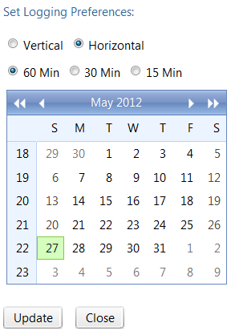
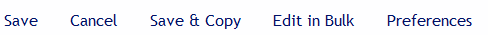
Adding Work Hours using the Graphical Method
  Go to Duty Hours > Log Hours > Preferences
  Select the Preferences link to update duty hour entry options.
  Select the Horizontal radio button, choose a month/date on the calendar, and then click Continue.
Notes:
The graphical method is an easy way to log hours for a day or two at a time. By default, the system defaults to a vertical entry view, however, we recommend using the horizontal version because it is easier to see the assignment definitions. Once you have selected all of your options, you can click the continue button and it will take you to the logging screen.
Once the resident selects “Horizontal” as their preference, RMS will automatically default to this setting.
NOTE: It’s our preference to view the duty hour entry in the Horizontal view but this is not required and completely up to the users preference.
***Demo – you may want to demo this for your residents/fellows rather than going through the slides (Hide this slide if doing a demo and switch to RMS).

Slide 22
Adding Work Hours using the Graphical Method
  Using the Duty Type drop-down menu, find the duty type that you would like to log.
  Select a day and time on the graph and hold down the left mouse button, “painting” your time from left to right across the screen.
  To erase: move your mouse backward over the entry until the color disappears.
  NOTE: When you are finished logging, you MUST click the Save button! You will know your entry has been saved when the screen refreshes and your entries appear with a cross-hatch pattern.
Notes:
From the graphical screen, select a duty type from the drop down list. Do NOT change your “department/division” from the default.
If you accidentally make a mistake or want to erase hours, click on the square again and the coloring will go away.
Once you have finished adding your time, select the Save button in the lower left hand corner. Very Important: You must click Save in order for your time to appear! Once you have saved your entries, the hours will be grayed out with a cross-hatch pattern. This means that they have successfully saved.
In addition, if you have any duty hour violations, the affected period will be outlined in red.
***Demo – you may want to demo this for your residents/fellows rather than going through the slides (Hide this slide if doing a demo and switch to RMS).
The next slide shows what the graphical screen looks like when hours are being logged.

Slide 23
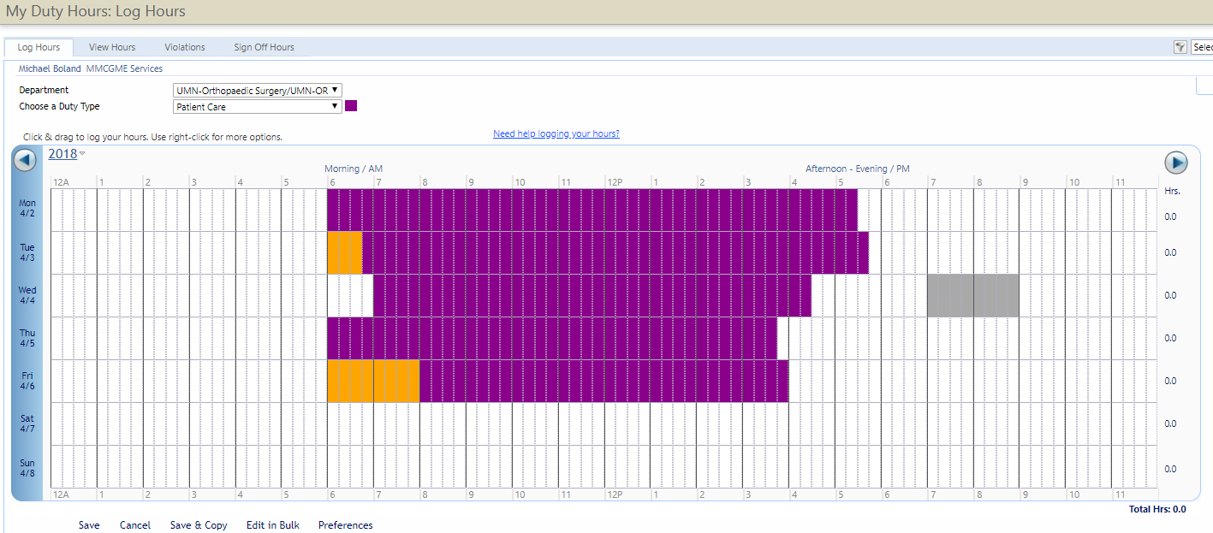
Adding Work Hours using the Graphical Method
Notes:
***Demo – you may want to demo this for your residents/fellows rather than going through the slides (Hide this slide if doing a demo and switch to RMS).
This is a screenshot of what the graphical screen looks like (what we just talked about on the last slide.) You can see the duty type drop down menu near the top of the screen. At the bottom are options to save, edit entries in bulk, cancel your entries, clear them, or change your preferences.

Slide 24
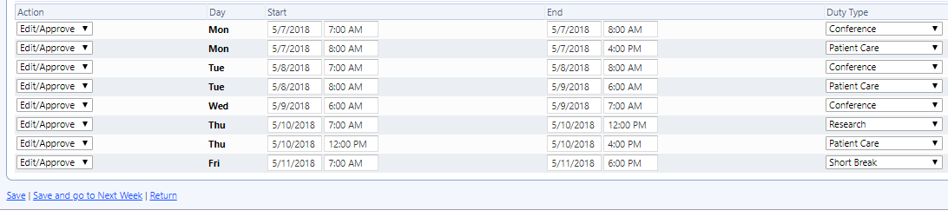
Viewing and Editing Work Hours
  Go to Duty Hours > View Hours > Edit in Bulk
  From the Action drop-down menu, select Edit/Approve, Delete or Did Not Work. The Start or End dates, time and assignment may also be edited.
  Click Save.
Notes:
If you notice that something you already put in is incorrect, or if you would like to view your hours, you can do that by going to the “My Duty Hours” option in the Duty Hours module. From this screen, you can enter a time frame by selecting “Preferences”, select “Update,” Then choose “Edit in Bulk” and you will see a list of entries that you have logged during that time period. If you need to make any edits to the entries, you can do so by selecting an action from the “Action” drop-down menu (Edit/Approve, Delete, Did Not Work). In addition, you may alter the start date, end date, start time, end time and/or duty type for each work hour entry.
Note: This option allows you to edit multiple entries at once. The next slide demonstrates how to edit a single entry.
***Demo – you may want to demo this for your residents/fellows rather than going through the slides (Hide this slide if doing a demo and switch to RMS).

Slide 25
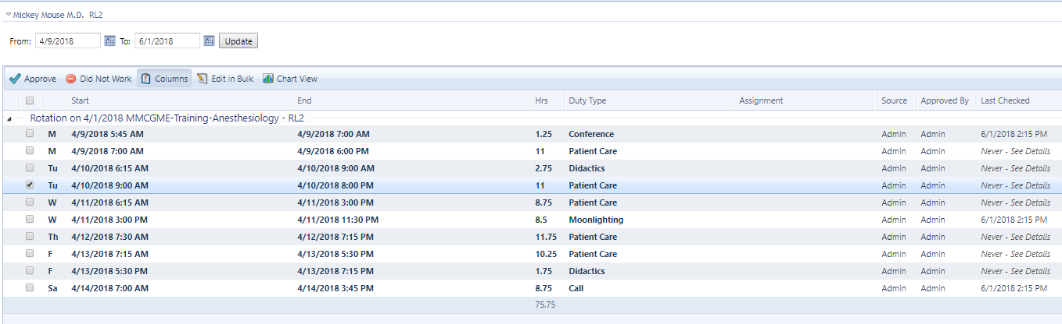

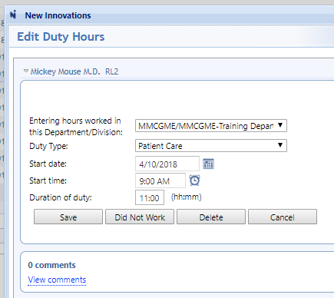
Editing Work Hours – Alternate Option
Go to Duty Hours > View Hours
Notes:
To edit a single work hour entry, go to the “View Hours” tab and hover over the far left on the line of the instance that needs editing. A double-down arrow symbol will appear. Click edit and a new pop-up window will appear. From this new window you can change the duty type, start date, start time and/or duration, then click the “Save” button.
***Demo – you may want to demo this for your residents/fellows rather than going through the slides (Hide this slide if doing a demo and switch to RMS).

Slide 26
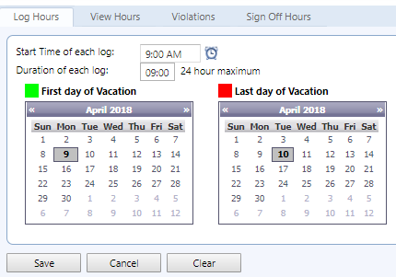
Logging Time Off
Notes:
***Training Note: If you have your residents contact you to add vacation or are using the time off manager, you may need to edit this slide.
***Demo – you may want to demo this for your residents/fellows rather than going through the slides (Hide this slide if doing a demo and switch to RMS).
Select the first date of vacation from the calendar on the left then wait for the screen to refresh
Select the last date of vacation from the calendar on the right
Click Save

Slide 27
Tips/Tricks
Enter duty hours by the 5th working day of each month.
Minimize gaps in your schedule.
Time logged for past work hours is automatically approved. If you are logging future work hours, you will have to go back and approve them once they have occurred (your program may not allow logging future hours).
Items that overlap or conflict appear with a red asterisk next to them and won’t be approved.
Notes:
Here are some helpful hints to take into account when logging your time. If you come across a scenario that you are unsure how to handle, contact your program/RMS coordinator.
Make sure your time is entered and complete for the entire previous month by the 5th working day of the new month
Try to avoid gaps in your schedule as much as possible.
Time that is logged in the past will automatically be approved. If you add a duty type for the future (or try to log in advance) the system will let you enter the time but you will have to go back and approve it once the time has passed.
Items that overlap or conflict appear with a red asterisk next to them. Items that overlap cannot be approved until the conflicting item has been corrected. If you have hours that you think you approved that are not showing up, check to see if there are conflicts and fix them in order to approve.

Slide 28
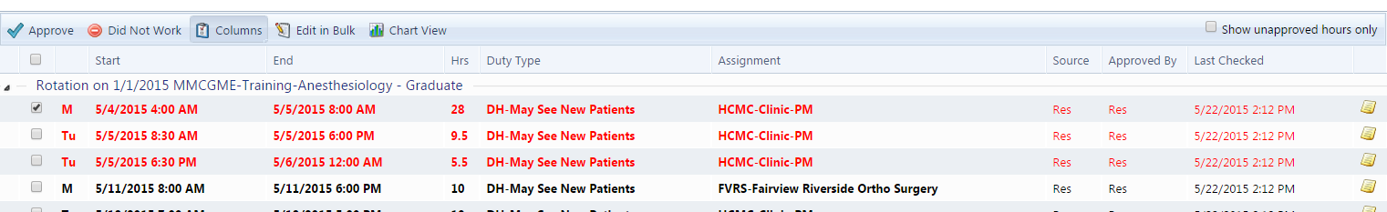
Work Hour Violations
Duty Hours > View Hours
Duty hour violations will appear in red
To add a comment, click on the notepad icon
To add a cause, click on “Details” to the far left of the log.
View Hours
Edit
Delete
Details
Notes:
Duty Hours > View Hours
When viewing/editing in bulk the duty hour entries, violations will appear in red as illustrated in the screenshot. Comments can be entered by clicking on the notepad icon associated with the entry in questions. Notice that if a comment is already entered, the notepad displays with a green checkmark. To add a “cause” for the violation, click on Details to the left of the log.
In the Graphical Entry (Not Pictured) violations will display as a red outline around each cell.
***Demo – you may want to demo this for your residents/fellows rather than going through the slides (Hide this slide if doing a demo and switch to RMS).

Slide 29
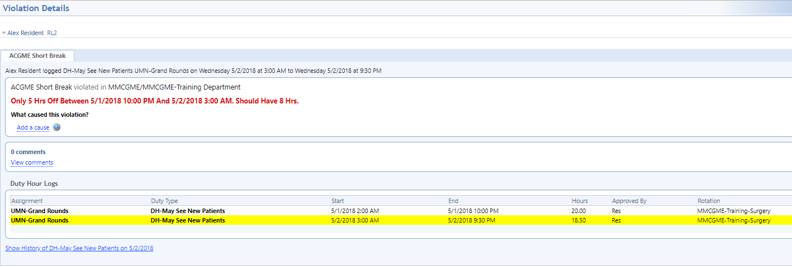
Duty Hour Violations
You may use the “Violations” tab to see your violations. You may add a “cause” for the violation by clicking on the Rule that was violated for that log.
Notes:
Another way to view violations is to click on the “Violations” tab in the “My Duty Hours” section. Once you are on this tab, you can see your violations in the last 30 or 90 days, 6 or 12 months in the “Violations” box.
The ACGME allows residents to stay or return to duty for a limited number of reasons including for continued care of an extremely ill patient, extraordinary/rare training experience, or other compassionate reason. If you have violated your hours for one of these reasons, you can add cause by clicking on the rule for that.
log.
***Demo – you may want to demo this for your residents/fellows rather than going through the slides (Hide this slide if doing a demo and switch to RMS).

Slide 30
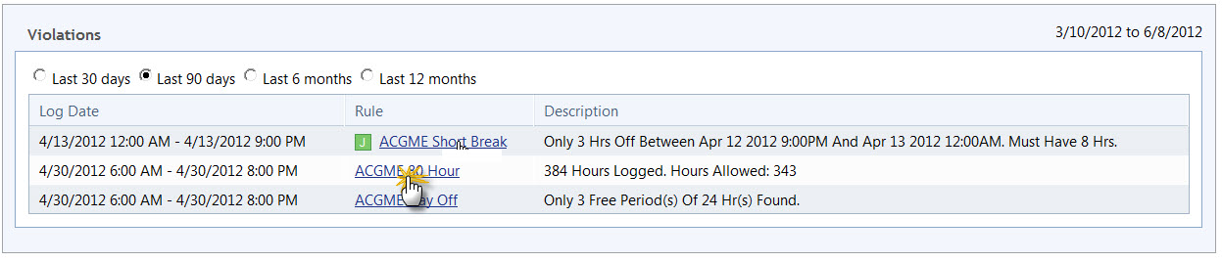
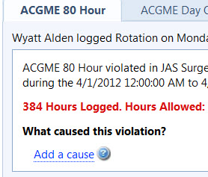
Causes for Violations
Notes:
Duty Hours > Violations
The resident/fellow has the option to click on the hyperlinked name of the rule to get more detail on the violation. From there, the resident/fellow can click on “Add a cause” to select a cause for the violation.
Note: Causes can also be accessed from the Violations tab.
***Demo – you may want to demo this for your residents/fellows rather than going through the slides (Hide this slide if doing a demo and switch to RMS).

Slide 31
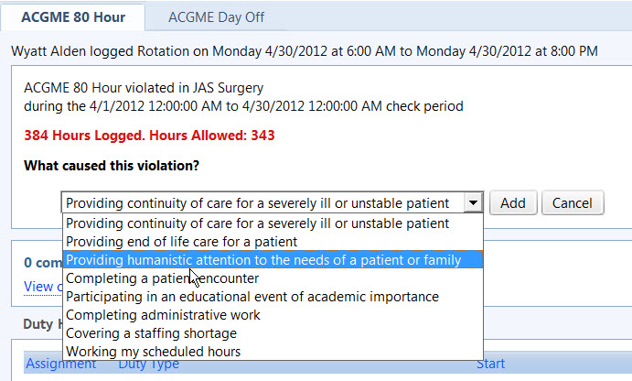
Add Cause
Duty Hours
Notes:
The resident/fellow can select a cause from the drop-down menu, then click “Add.” Multiple causes may be selected for one violation (as many as necessary).
Administrators will also have the ability to add a cause on behalf of a resident/fellow.
***Demo – you may want to demo this for your residents/fellows rather than going through the slides (Hide this slide if doing a demo and switch to RMS).

Slide 32
Other RMS Modules You Will Use
View Rotation Schedules
View and Approve Curriculum
View Conferences/Conference Reports
Complete Evaluations/Run Reports
Enter Scholarly Activities & Journal entries
View Portfolio Reviews
Enter & View Procedures
View Milestones Report
Notes:
***Training Note: Customize this slide to include only the modules that your program uses. Also, only cover the following slides for modules that your program uses.

Slide 33
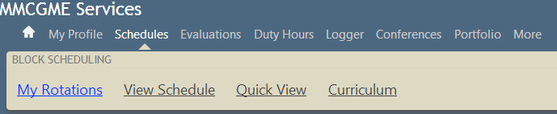
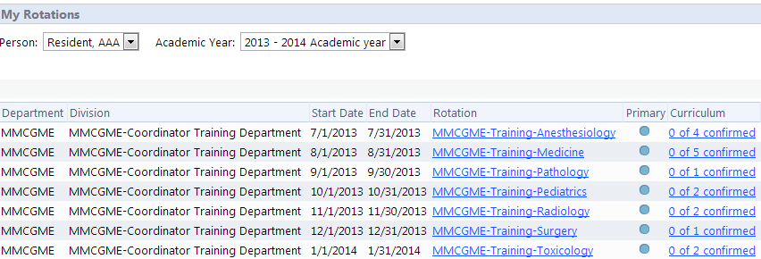
My Rotation Schedule & Curriculum
Rotation Information
Curriculum Information
Notes:
Schedules > My Rotations
Curriculum is hyperlinked in the resident/fellow block schedule. Clicking on the hyperlinked curriculum (noted on the screen by the green “Curriculum” box), will allow the resident/fellow to view curriculum associated with the specific rotation (as pictured in the next slide).
***Demo – you may want to demo this for your residents/fellows rather than going through the slides (Hide this slide if doing a demo and switch to RMS).

Slide 34
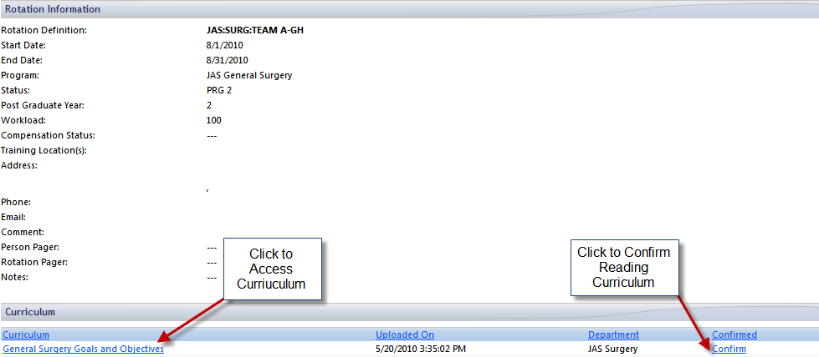
My Rotation Schedule & Curriculum
Notes:
This page is accessible by clicking on the hyperlinked curriculum via the block schedule (as pictured in the previous slide).
The resident/fellow can click on the hyperlinked document(s) in the “Curriculum” column to view the attached documents. The resident/fellow must then click on the “Confirm” hyperlink to the right-hand side, to date and time stamp confirmation of reading the required document(s).
Note: Residents/fellows will only be able to confirm reading the documents x (determined by the program) number of days before the rotation begins, but at any point after the rotation starts.
***Demo – you may want to demo this for your residents/fellows rather than going through the slides (Hide this slide if doing a demo and switch to RMS).

Slide 35
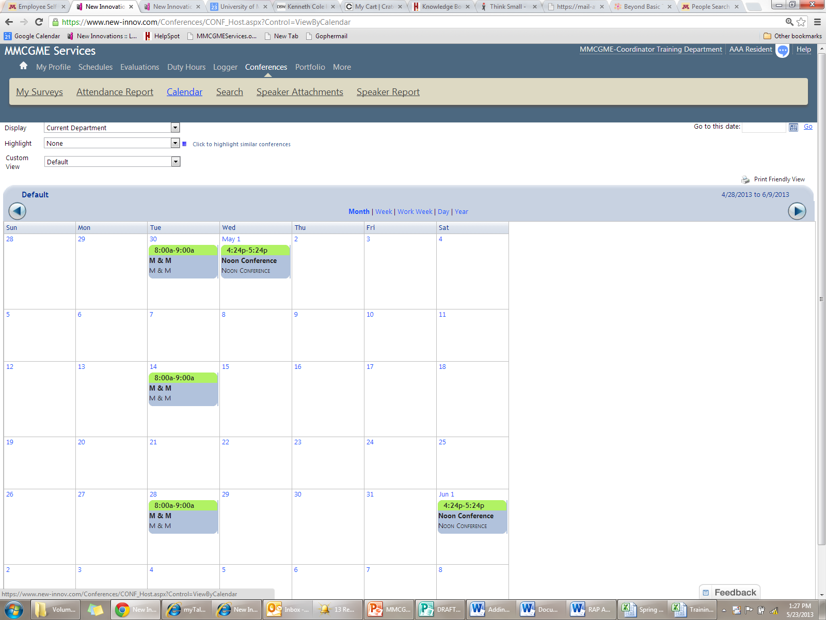
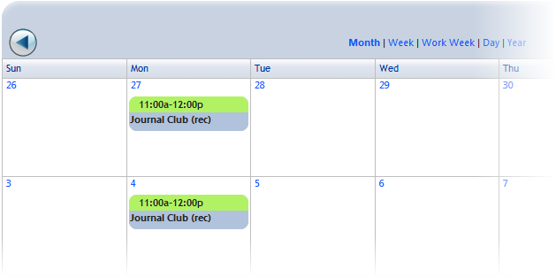
Conference Schedule
Notes:
This slide demonstrates how a resident can access their conference calendar (Conferences > Calendar).
Click on the conference occurrence in the calendar to get more details on a specific conference.
***Demo – you may want to demo this for your residents/fellows rather than going through the slides (Hide this slide if doing a demo and switch to RMS).

Slide 36
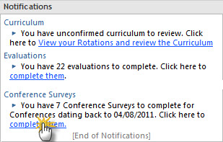
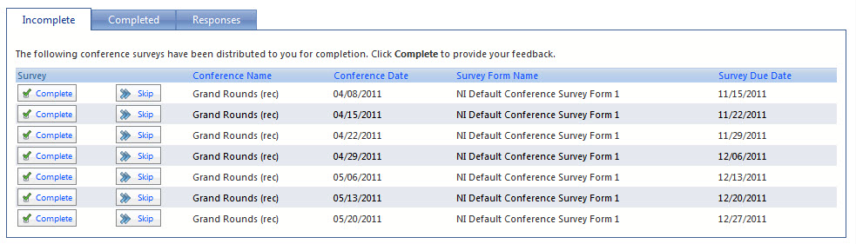
Conference Surveys
Click Complete to fill out the survey or click Skip to remove it from the grid
Notes:
This slide demonstrates how to access Conference Surveys via the Notifications tab on the Home page. From here, you can either complete or skip the conference surveys.
Residents can also access conference surveys from the top menu ribbon by selecting Conferences > My Surveys.
(The method in which trainees access surveys is up to trainee/program preference.)
***Demo – you may want to demo this for your residents/fellows rather than going through the slides (Hide this slide if doing a demo and switch to RMS).

Slide 37
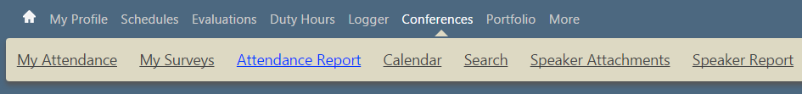
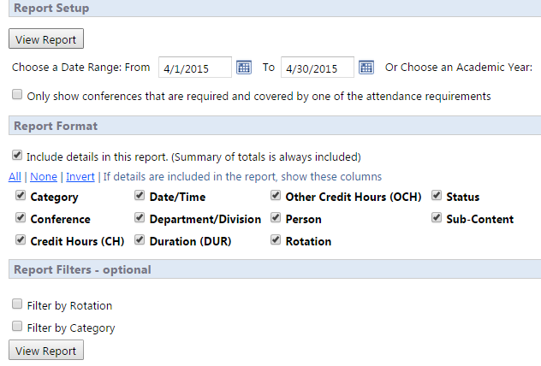
Conference Attendance
Notes:
This slide demonstrates how a resident can access their Conference Attendance Report (Conferences > My Attendance).
The Conference Attendance Report will display a list of all conferences for the program and whether the resident was marked present, tardy or excused.
***Demo – you may want to demo this for your residents/fellows rather than going through the slides (Hide this slide if doing a demo and switch to RMS).

Slide 38
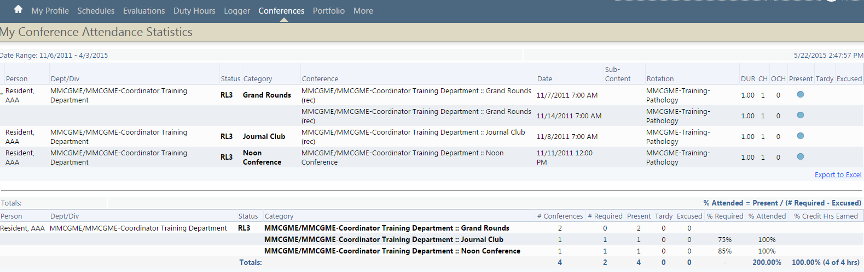
Conference Attendance
Notes:
Sample of the My Conference Attendance Report. The report will only display information for the resident/fellow logged in. It lists each conference by conference category, topic, date, sub-content (if applicable), rotation, CH=Credit Hours (not required), OCH-Other Credit Hours (not required), and whether they were marked present, tardy or excused. The bottom section of the report lists your overall conference attendance percentages by conference category. If the percentage is highlighted in red, it means that you are nor meeting the attendance requirements determined by your program.
***Demo – you may want to demo this for your residents/fellows rather than going through the slides (Hide this slide if doing a demo and switch to RMS).

Slide 39
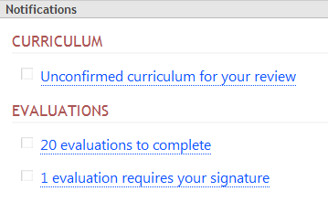
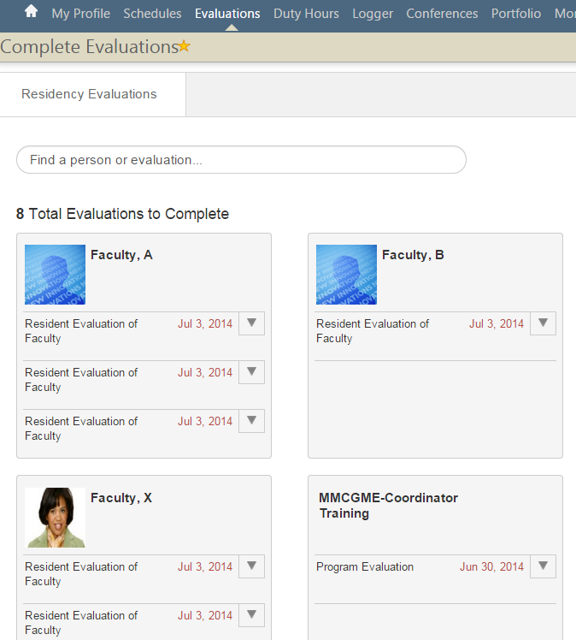
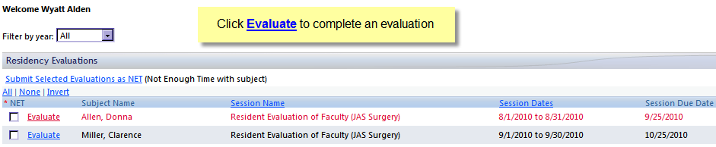
Evaluations
Notes:
The Notification pod (Pictured above) is located on the resident/fellows Home page. Note that if the Evaluation Notifications only appear when there are evaluations due for completion. Clicking on the “x evaluations to complete” hyperlink will open a page where each evaluation can be completed. Click each instance of an evaluation to complete. There is a display panel to the right side of this screen (not pictured) that provides an overview of current evaluations either available for completion or in draft form.
Residents/fellows can also access this area from the top menu ribbon by selecting Evaluations > Complete an Evaluation.
***Demo – you may want to demo this for your residents/fellows rather than going through the slides (Hide this slide if doing a demo and switch to RMS).

Slide 40
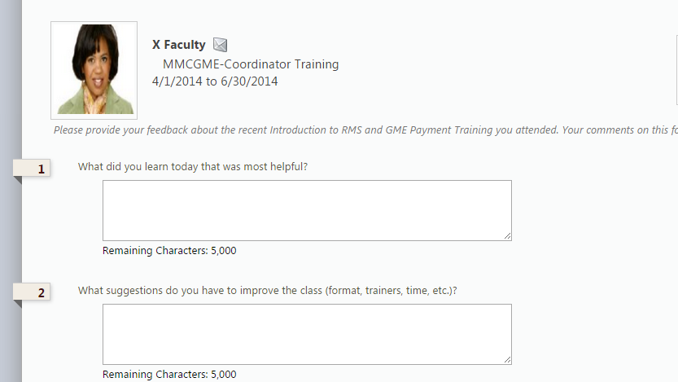
Assess
Enter feedback, sign, and submit
Notes:
Sample Evaluation.
***Demo – you may want to demo this for your residents/fellows rather than going through the slides (Hide this slide if doing a demo and switch to RMS).

Slide 41
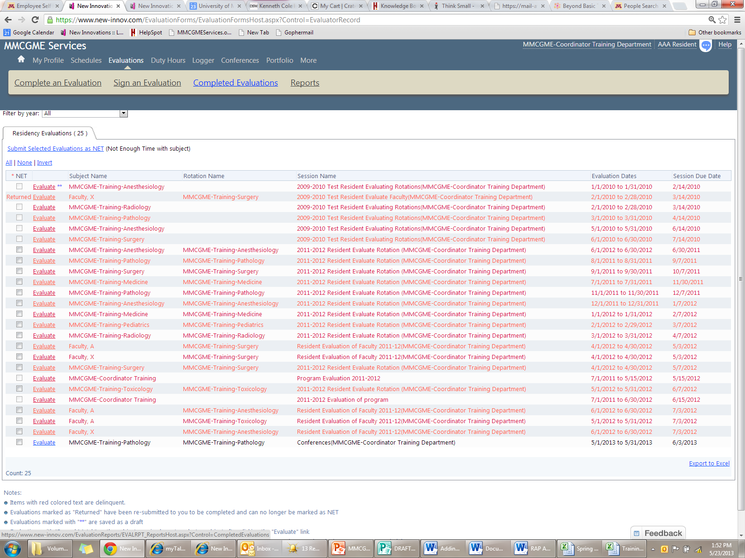
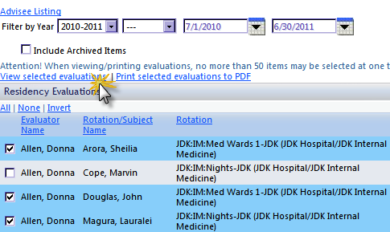
View Completed Evaluations
Notes:
This allows the resident to view all evaluations that they completed on other people, rotations, or the program and view evaluations that others have completed on them (excluding any anonymous evaluations).
Evaluations > Completed Evaluations
***Demo – you may want to demo this for your residents/fellows rather than going through the slides (Hide this slide if doing a demo and switch to RMS).

Slide 42
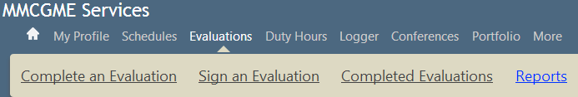
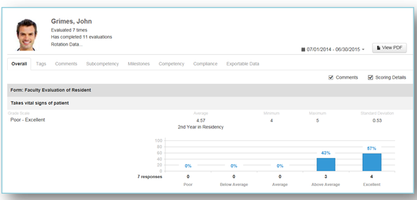
Evaluation Reports
Notes:
Evaluations >Reports
The Overall Report shows the results from every question on every evaluation form that was used to evaluate the resident/fellow. Comments are displayed by default.
This report displays the following information:
Name of the evaluation form
Question text
Grade scale used
Their average on that question
The Minimum and Maximum scores received, along with the Standard Deviation
Check Scoring Details to view a graphic representation of the results
***Demo – you may want to demo this for your residents/fellows rather than going through the slides (Hide this slide if doing a demo and switch to RMS).

Slide 43
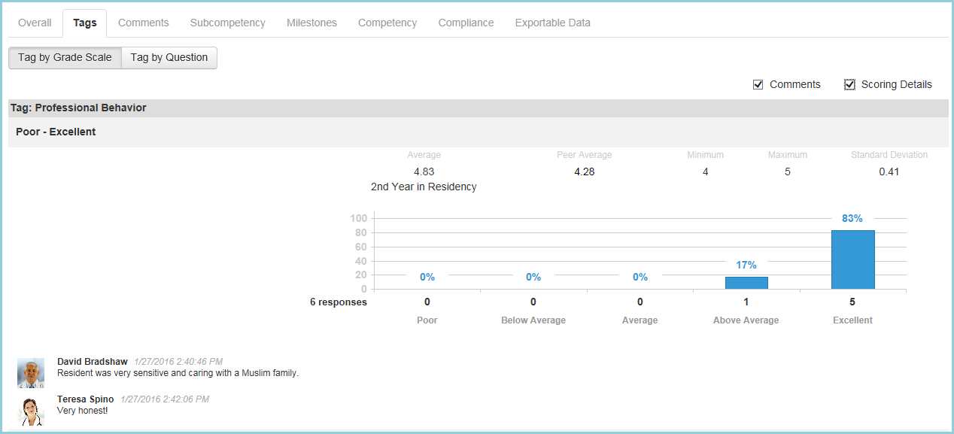
Tags Report
Notes:
The Tags report displays the results from Custom Tags placed on General questions.
***Demo – you may want to demo this for your residents/fellows rather than going through the slides (Hide this slide if doing a demo and switch to RMS).

Slide 44
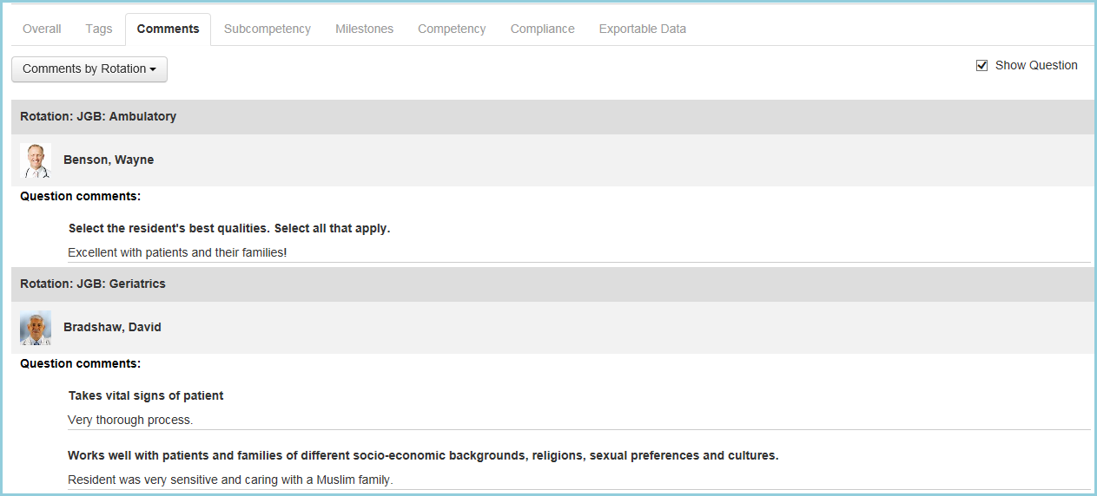
Comments Report
Notes:
There are four reports that can be generated to show evaluators' comments about you:
Comments by Evaluator
Comments by Rotation
Comments by Tag
Comments by Form

Slide 45
Other Reports
Subcompetency Report
The Subcompetency tab displays the results of evaluations completed on the resident where the questionnaires contain the following:
Actual subcompetencies
Responses mapped to subcompetencies, such as EPAs, custom subcompetencies and custom questions
Milestones Report
The Milestones tab displays the results of milestone questions.
Competency Report
The Competency tab displays data collected about the resident from Custom Questions where the Categories have been linked to Core Competencies.
Compliance Report
This report shows if the resident is compliant with completing evaluations assigned to them.
Exportable Data
This tab shows the actual scores given to the resident on each question. Click Excel to export this data to a spreadsheet format.

Slide 46
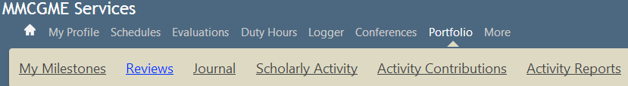
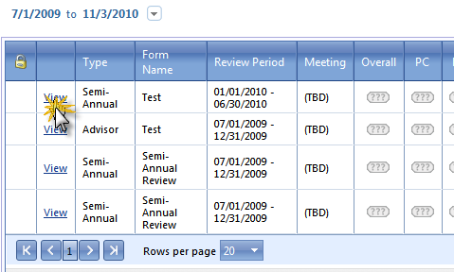
View Your Portfolio Reviews
Notes:
Portfolio > Reviews
Allows the resident to view all Portfolio reviews that have been completed on them.
***Demo – you may want to demo this for your residents/fellows rather than going through the slides (Hide this slide if doing a demo and switch to RMS).

Slide 47
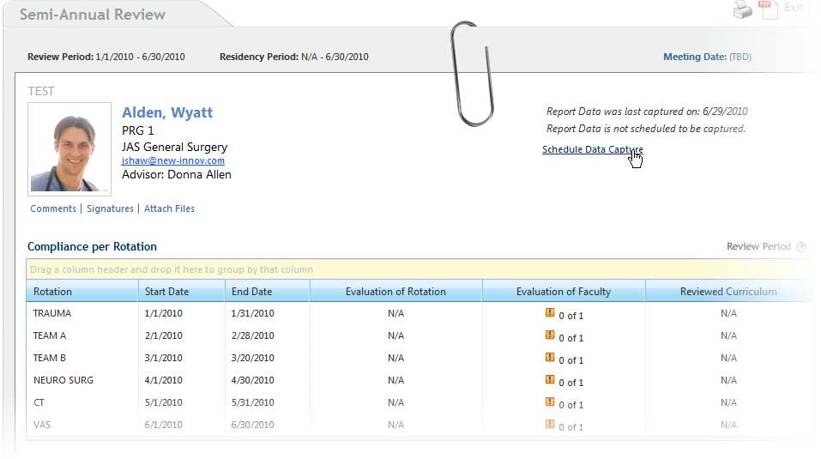
View Your Portfolio Reviews (Cont.)
Notes:
Sample Portfolio review
***Demo – you may want to demo this for your residents/fellows rather than going through the slides (Hide this slide if doing a demo and switch to RMS).

Slide 48
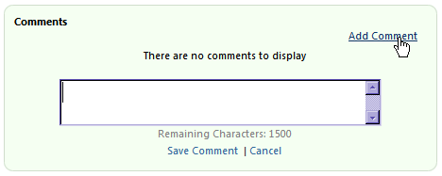
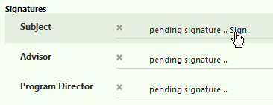
Add Your Comments & Signature
Notes:
Designated area for the resident to enter comments on the Portfolio review and also sign the review.
NOTE: The option to allow subject signatures on the review form must be configured in your program specific review form template(s). To configure this setting, select Portfolio > Form Templates (Under Review Header) > Click Edit (Or New if creating a new Form) > Under the Signatures & Comments section, check the box for “Allow comments from Subject” (and any other status types that may apply). Keep in mind that this only adds the comment option going forward, it does not retroactively allow for comments on completed reviews.
***Demo – you may want to demo this for your residents/fellows rather than going through the slides (Hide this slide if doing a demo and switch to RMS).

Slide 49
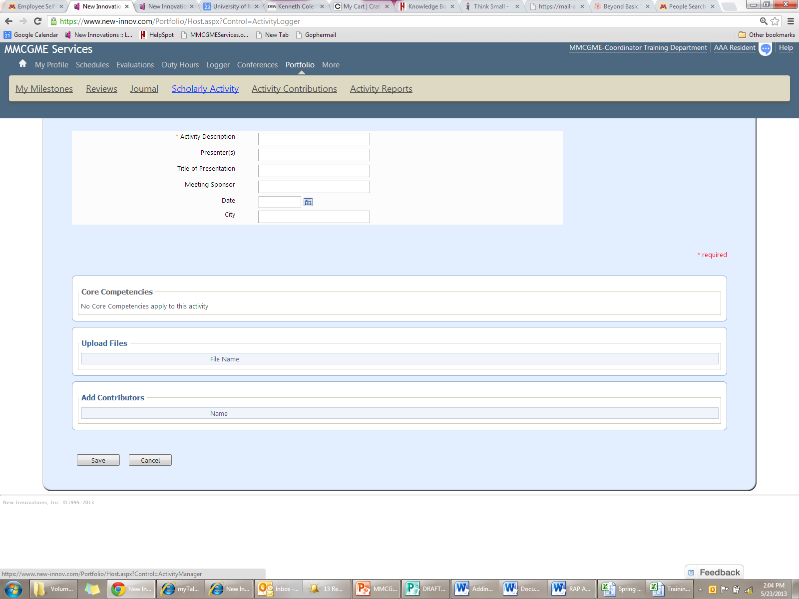
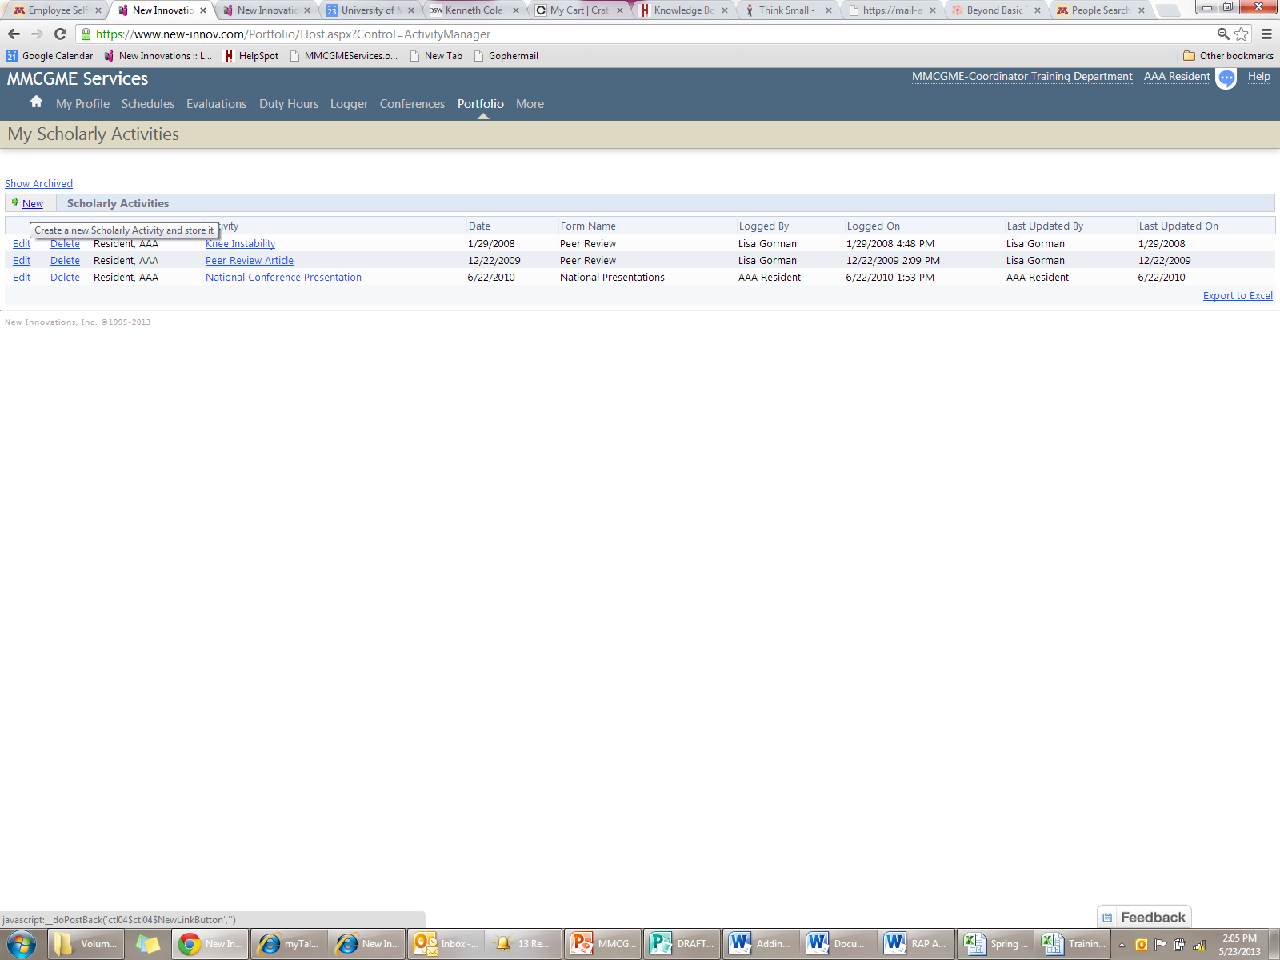
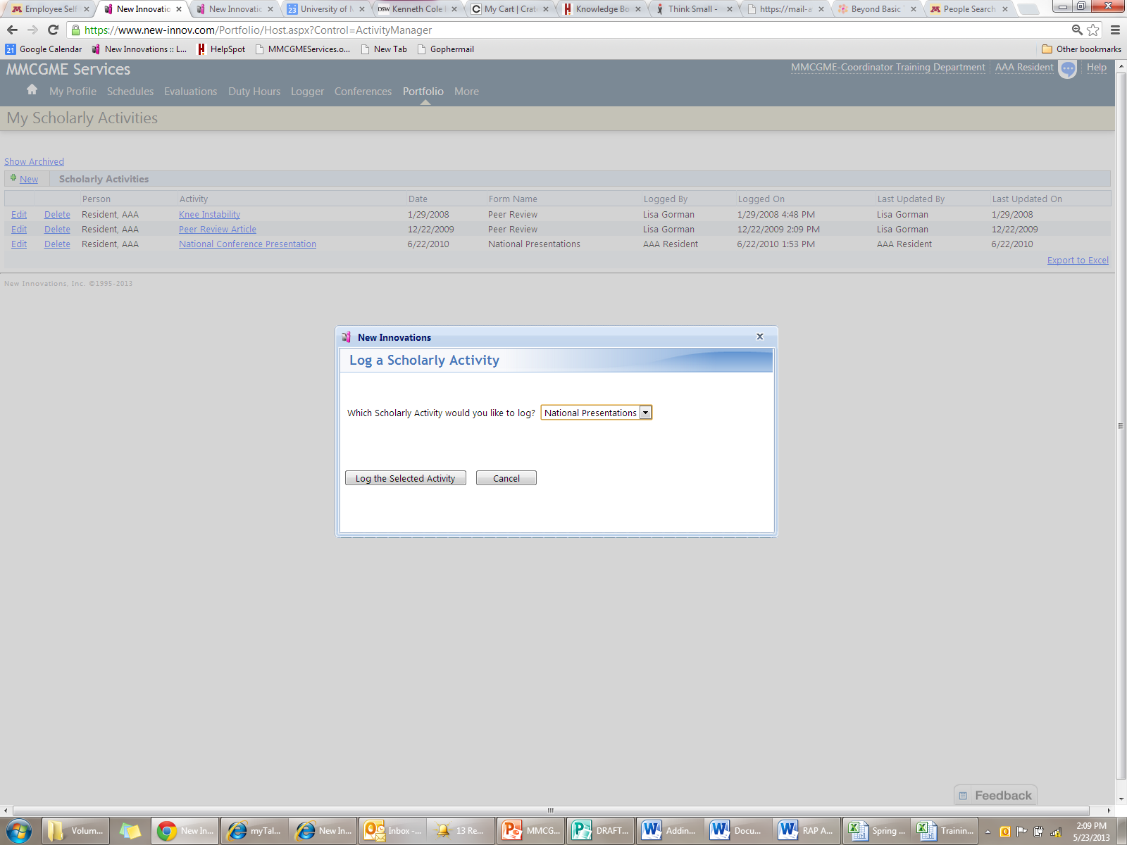
Add Scholarly Activities
Notes:
Portfolio > Scholarly Activity > New> Select a scholarly activity from the drop-down menu > Log the selected activity
This slide demonstrated how the residents access the scholarly activity portion of the Portfolio module to log new activities.
***Demo – you may want to demo this for your residents/fellows rather than going through the slides (Hide this slide if doing a demo and switch to RMS).

Slide 50
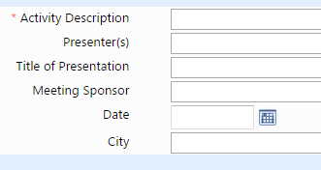





Add Scholarly Activities
Enter Activity Details
Select Core Competencies
Add files and Contributors
Notes:
Demonstration of logging a scholarly activity. Enter the activity details (those noted with an orange asterisk are required), then select the core competencies to which the log applies, choose the contributors and add pertinent files.
Portfolio > Forms (under the Scholarly Activities header) >
***Demo – you may want to demo this for your residents/fellows rather than going through the slides (Hide this slide if doing a demo and switch to RMS).

Slide 51


Journaling
Notes:
Residents can complete Journal entries via the Portfolio module. Journals are collections of individual journal entries created by users in the Portfolio module. Anyone who has access to the Portfolio module can create journal entries independently. These journal entries can be kept private so that only the author may access them. Or they can be made public, which means that the Program Director, Associate Program Director, Advisor and Program Administrator can see the entry. Anyone who has access to the entry can comment on it. Alternately, administrators can create journaling assignments for trainees in their program.
Portfolio > Journal
***Demo – you may want to demo this for your residents/fellows rather than going through the slides (Hide this slide if doing a demo and switch to RMS).

Slide 52



Journaling
Public Journal Entries can be seen by administrators and key educators like the Program Director and Advisors
Private Journals can only be seen by the author
Notes:
Demonstration of how to complete a Journal entry.
Select “Add New Journal Entry” (displayed on previous slide). Then, can click over “My Journal Entry” to begin typing a header. You may click over “Start writing here…” to begin typing the journal entry. You can select whether the entry should be public or private. Under Core Competencies, clicking on the hyperlink (Practice-Based Learning and Improvement) will open a checklist where you can select which core competency this journal entry is related to. Then either select Save Draft, Publish or Cancel.
***Demo – you may want to demo this for your residents/fellows rather than going through the slides (Hide this slide if doing a demo and switch to RMS).

Slide 53


Journaling Assignments
Notes:
Portfolio > Journal > Show Assignments
This slide demonstrates access to the Journal assignments. Clicking the “Show Assignments” link opens a window where you can complete the assignment. The next slides demonstrates completing a Journal assignment.
***Demo – you may want to demo this for your residents/fellows rather than going through the slides (Hide this slide if doing a demo and switch to RMS).

Slide 54


Journaling Assignments
Note the instructions and click the journal page to begin writing.
Click Publish to submit the assignment
Notes:
Once the assigned journal entry is complete, be sure to click the “Publish” button.
***Demo – you may want to demo this for your residents/fellows rather than going through the slides (Hide this slide if doing a demo and switch to RMS).

Slide 55


Log Procedures
Enter Procedure Details
Select Supervisor
Save and Retain information or Save and Clear the form
Click View Log Listing to see Procedures logged
Notes:
Logger > Procedures
The procedure logger form is configured by a program administrator for residents/fellows to complete. Note: Clicking the “Add Procedure” link allows you to add another procedure to the same patient. Be sure to click the “Save” button at the bottom of the screen once the entry is complete.
***Demo – you may want to demo this for your residents/fellows rather than going through the slides (Hide this slide if doing a demo and switch to RMS).

Slide 56

View Log Listing
Change date range and Choose what to view from the “Show” drop-down menu.
Notes:
Logger > Procedures and choose the View tab / Alternately, the log listing can be accessed by selecting Logger > Procedures > View Log Listing
Note that the date range can be edited as pictured on the slide. The list displays all procedures logged by the resident/fellow be date, Procedure type, supervisor, passed/not passed, confirmation status & confirmation date.
Once a procedure has been confirmed by the supervisor, it can no longer be edited or deleted by the resident/fellow.
***Demo – you may want to demo this for your residents/fellows rather than going through the slides (Hide this slide if doing a demo and switch to RMS).

Slide 57

Milestones – Resident Review Report
Notes:
Portfolio > My Milestones
The Milestones feature is variable by program. Be sure to modify the information you share to fit how your program manages the milestones:
How often are the reviews performed?
How are the results shared?
Who will they talk to about their results?
The Resident Review Report is a spider graph that displays the Milestone Review scores given to the resident for each review period with the detail below providing information on the current period. Each spoke of the spider graph represents a sub-competency, such as Patient Care 1 (PC1) and the concentric circles represents the scores from 0 to 5.
***Demo – you may want to demo this for your residents/fellows rather than going through the slides (Hide this slide if doing a demo and switch to RMS).

Slide 58
Next Steps
  Begin using RMS immediately
  Use RMS at least weekly to enter the assignments you worked
  Contact your Program/RMS Coordinator if you have any questions about which assignment(s) you should be using
  Remember: Your work hours are viewed by many people including your PD, Program Coordinator, GME office, hospital coordinators and billing and reimbursement people who all depend on you to accurately enter your activities!
  Read your curriculum and complete your evaluations on a timely basis!
Notes:
So what are your next steps?
First, begin using RMS immediately (Program Coordinator will conduct periodic audits to ensure information is accurate and current).
Next, go into RMS regularly to approve/update your schedule.
If you are unable to find an assignment definition that fits what you are doing, contact your Program Coordinator for help or so that they can add a new assignment for you to use.
Finally, remember that a lot of people depend on and will be viewing your work hours so it is essential that you enter them accurately and on time.

Slide 59
Questions?

