Slide 1
RMS MOMENT OF THE MONTH
Creating a New Academic Year
Metro Minnesota Council on Graduate Medical Education
Notes:
Today we are going to go over how to create a new academic year. Doing this is important because it is used to define different time periods for: block schedule, evaluations, finance applications, and more.

Slide 2
MEETING AGENDA
How-to Create a New Academic Year
Available Resources
Training Opportunities
Notes:
We will show you to create a new AY, adjust the intervals, talk about the option to create different blocks, and the available option of creating a recurring academic year.

Slide 3
How to Create a New Academic Year in RMS
Notes:
How to adjust the intervals
Talk about the different block options
Mention the recurring academic year option

Slide 4
AVAILABLE RESOURCES
Below are the training materials:
Training Manual
Training Course Outline
FAQs
​Additional Resources:
Preparing for the New Academic Year Tasks
Notes:
Training manual – how to create an AY - page 7

Slide 5
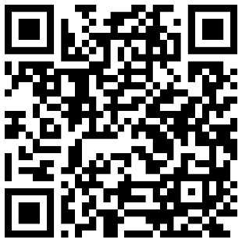
TRAINING OPPORTUNITIES
Block Schedules (required)
Introduction to RMS & GME Payment
Evaluations
Conferences
Onboarding & Checklists
Curriculum​
Portfolio Review
​Scholarly Activity
Statements of Activity/Billing
Logger, Log Books, and Continuity Clinic
Journals
Custom Reports
Work Hours
Agreements​
Notes:
Visit the mmcgme training website or scan the QR code to register for additional training
(https://www.mmcgmeservices.org/training.html)

Slide 6
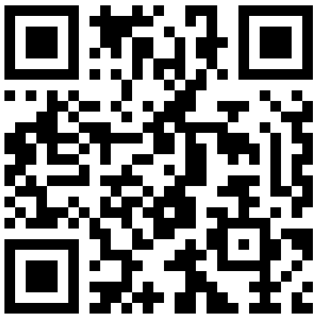
THANK YOU!
www.mmcgmeservices.org

